Slide 1
Lead User Guide: Application for Firm Certification
Updated 05/11/2018
Notes:
Welcome to the online tutorial for the Lead Program’s Application for Firm Certification. This tutorial will walk you through the process of completing and submitting an application for certification to EPA under the Renovation, Repair, and Painting (RRP) or Abatement programs.

Slide 2
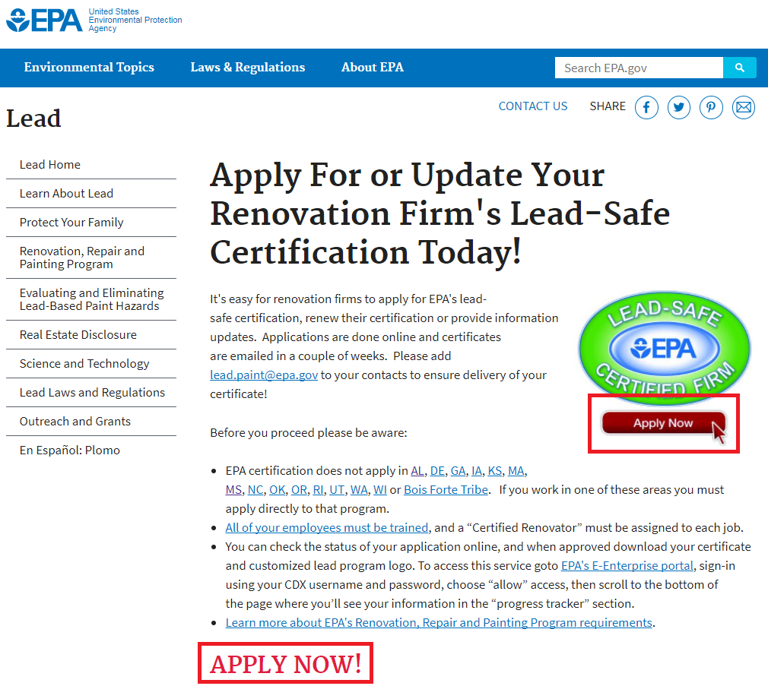
Firm Public Site
https://www.epa.gov/lead/getcertified
Notes:
The Firm Certification application can be accessed through EPA’s Lead-Safe Certification Program public website, located at https://www.epa.gov/lead/getcertified. To enter the application, click the “Apply Now” logo or link on this page,

Slide 3
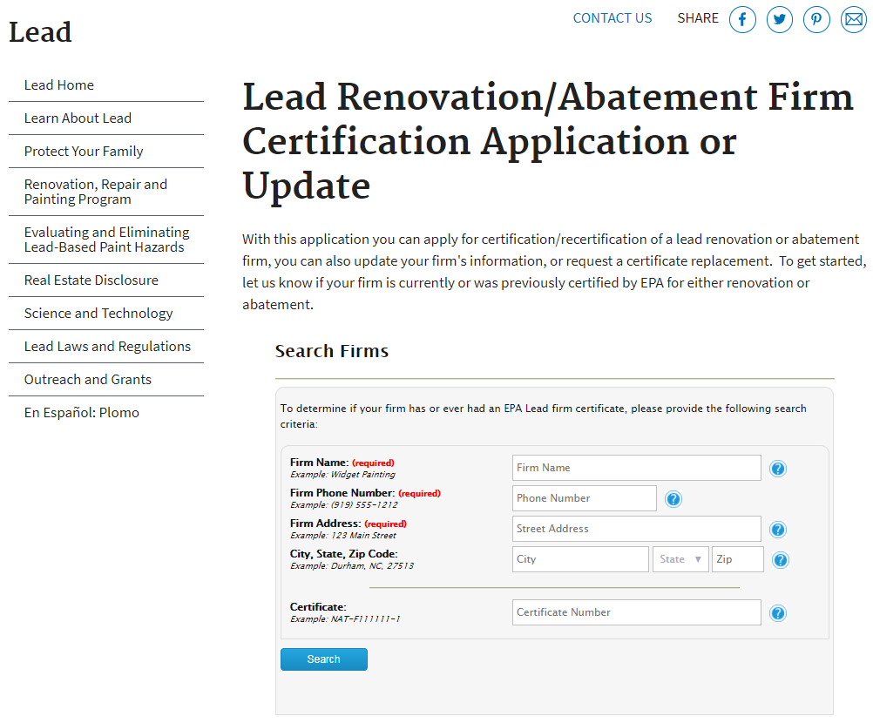
Firm Search
Notes:
All firms, both certified and firms seeking certification must use the Firm Search to locate their firm. A business with a current certification can send an application for recertification, send in an amendment to update their firm’s information, or request a replacement copy of their certificate ($15). A business seeking certification has the option to begin the application to certify a new firm.
The business must enter their firm name, firm phone number, and firm address into the respective fields.

Slide 4
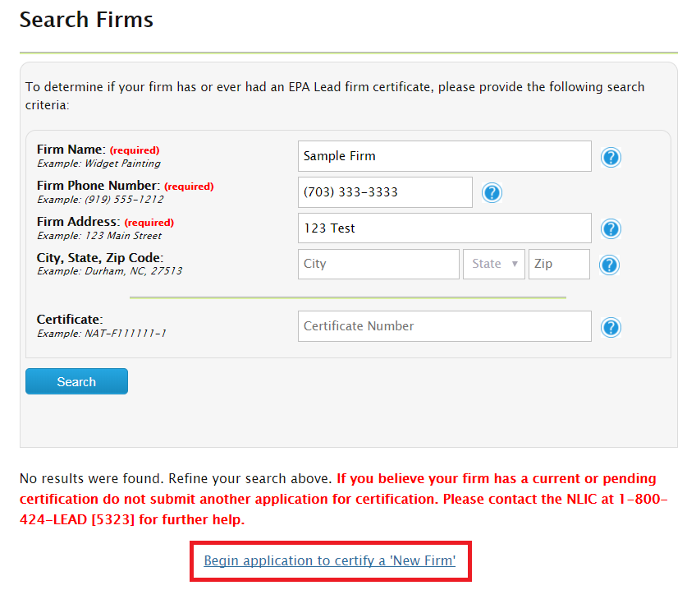
Firm Search – Application Link for New Firm
Notes:
Firms that have never been certified will have the option to begin a new application by clicking the link highlighted above. Users will only be able to access this link after looking for their firm using the search.

Slide 5
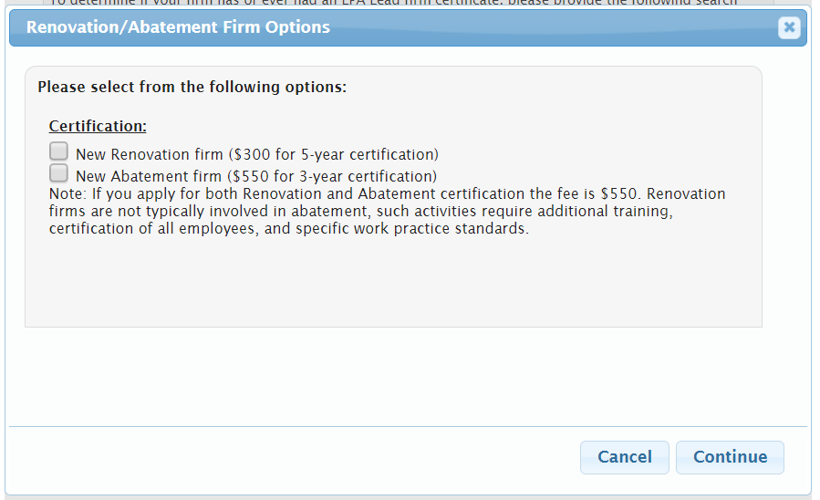
Firm Certification Options
Notes:
Clicking the link to begin the application to certify a new firm will open a pop up window. In this window, you can select to apply for certification as either a Renovation (RRP) or an Abatement firm. Selecting both boxes will allow you to apply for both certifications using one combined application.
Note: Once a Firm is certified, they will not be granted a refund. The user needs to make sure that they are applying for the proper certification. EPA’s full refund policy can be found at https://www.epa.gov/lead/epa-certification-program-fees-renovation-firms-and-abatement-firms.

Slide 6
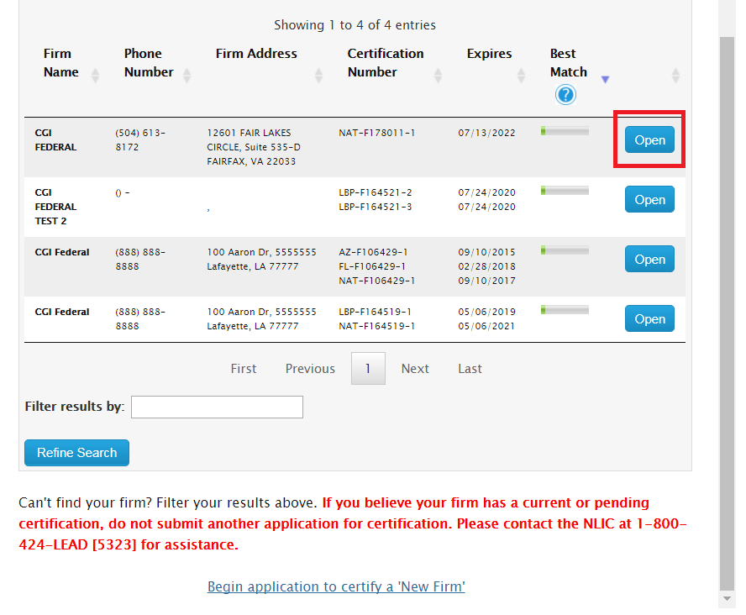
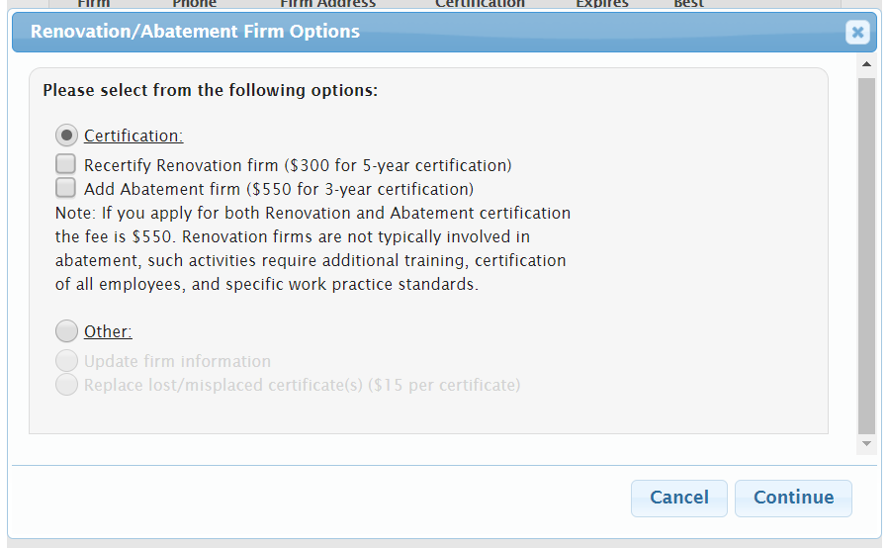
Firm Search Results
Notes:
Firms who find themselves on the search can click “Open” and do any of the following: apply for recertification, update their firm’s information, or place a request for a replacement certificate.
Firms seeking to recertify should select the “Certification” option in the pop up window. Their recertification options will depend on what certifications they currently possess. In the example on this slide, the sample firm only holds a Renovation (RRP) certification, so the recertification option is only available for this discipline. This sample firm can choose to send an application to get certified as an Abatement firm, but that will be considered an initial application. Firms that have both Renovation (RRP) and Abatement certifications are able to choose which certification they need to recertify.

Slide 7
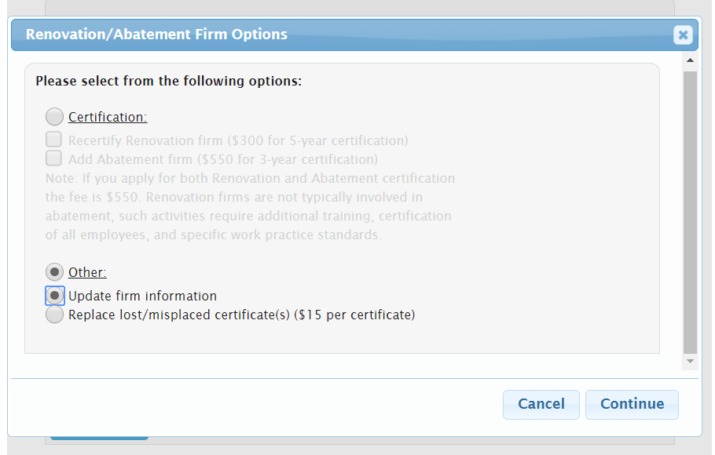
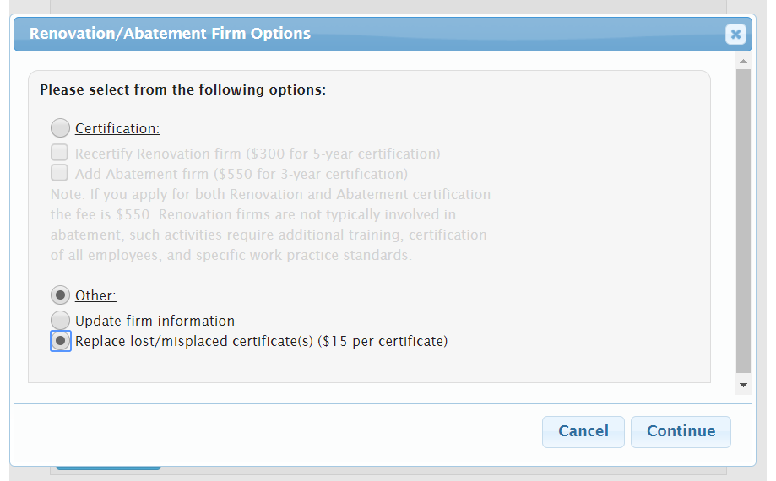
Options to Update Firm Information or Replace a Certificate
Notes:
Firms seeking to update their information or request a replacement copy of their certificate should select the “Other” option in the pop up window. The “Update firm information” option will open an Information Amendment application, where the user can update the information on their previous application. The “Replace lost/misplaced certificate” option will open an application to receive a replacement copy of the user’s certificate. Each certificate is $15.

Slide 8
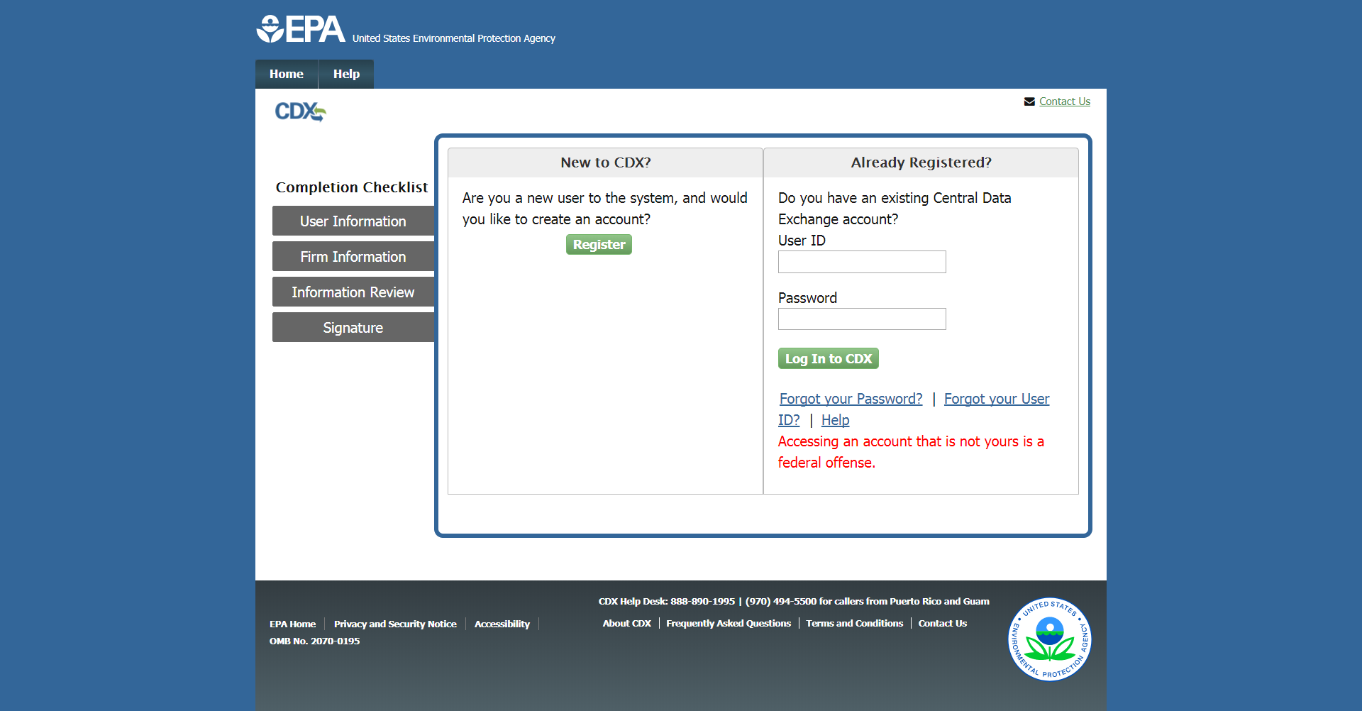
Update Firm Information – CDX Log In Page
Notes:
Firms seeking to update their information will be led to the CDX log in page. The user must enter their CDX user ID and password to sign in.

Slide 9
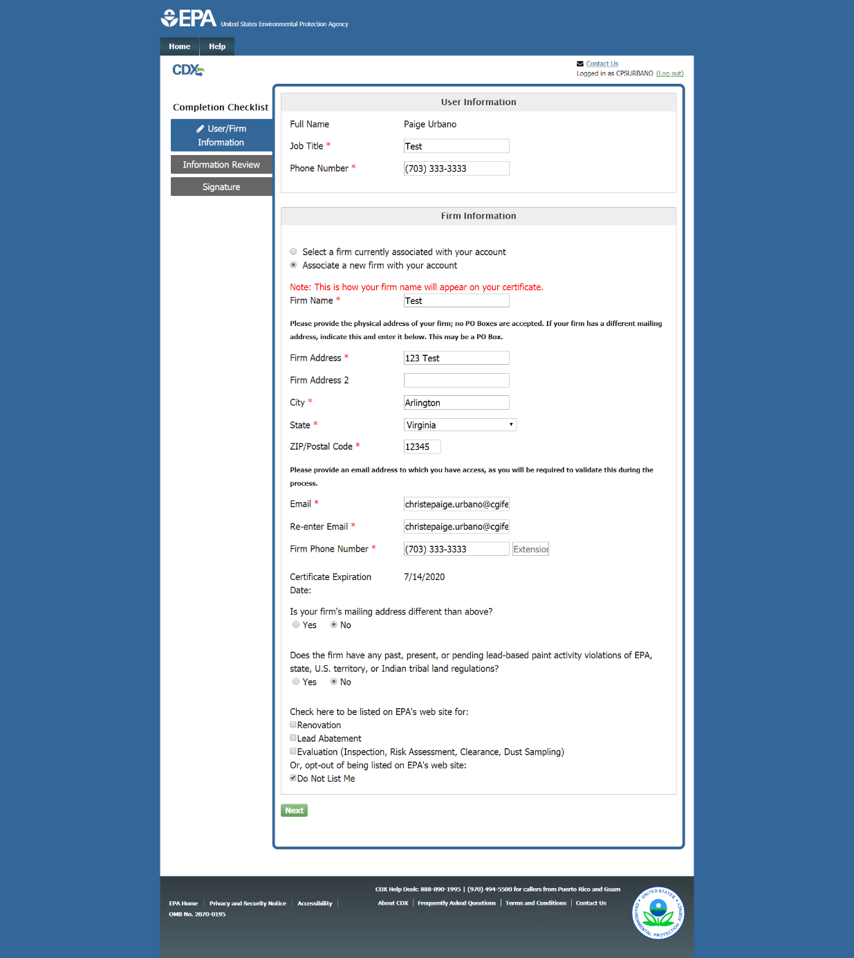
Update Firm Information – Edit Page
Notes:
After logging in, the user is led to the edit page. On this page, the user can make any edits to their firm’s information.

Slide 10
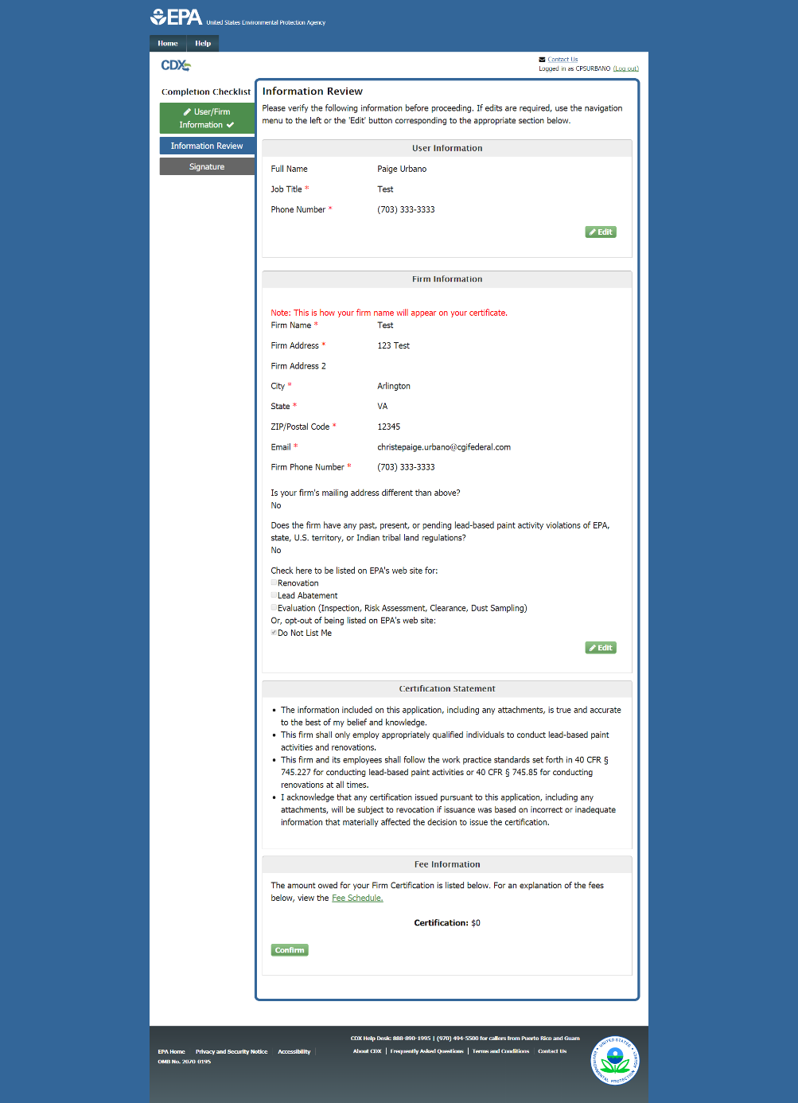
Update Firm Information – Review Page
Notes:
Any information edited by the user in the previous page is displayed in read-only format on the review page. The information on this page should be checked for accuracy. If the user needs to make any edits, click the “Edit” button to return to the edit page. If all the information is correct, click “Confirm”.

Slide 11
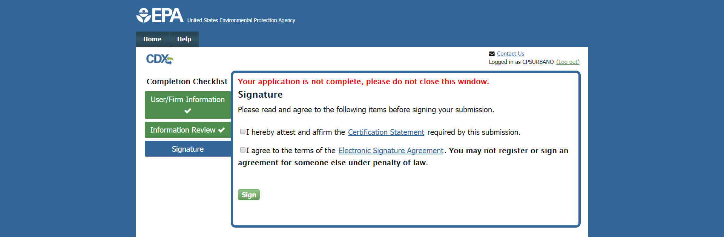
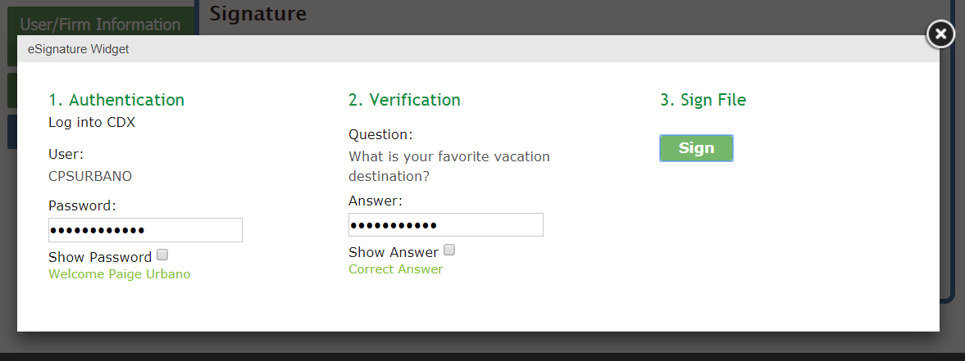
Update Firm Information – Signature Page
Notes:
The user is then navigated to the signature page. Here the user must agree to the terms before signing their submission via the eSignature widget. The user must enter their password and answer a verification question to sign their submission.

Slide 12
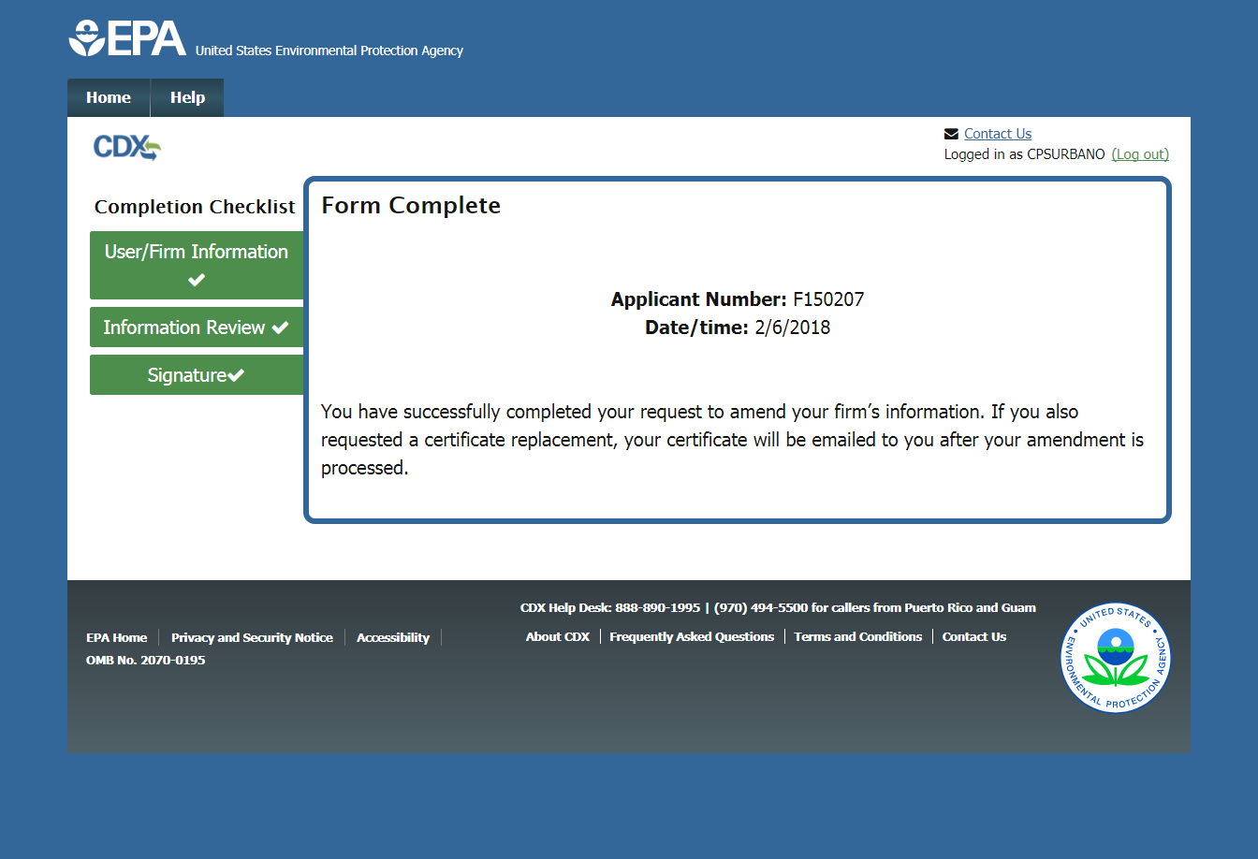
Update Firm Information – Confirmation Page
Notes:
After signing their submission, the user is led to the confirmation page.

Slide 13
Replace a Certificate – CDX Log In Page
Notes:
Firms seeking to replace their certificate will be led to the CDX log in page. The user must enter their CDX user ID and password to sign in.

Slide 14
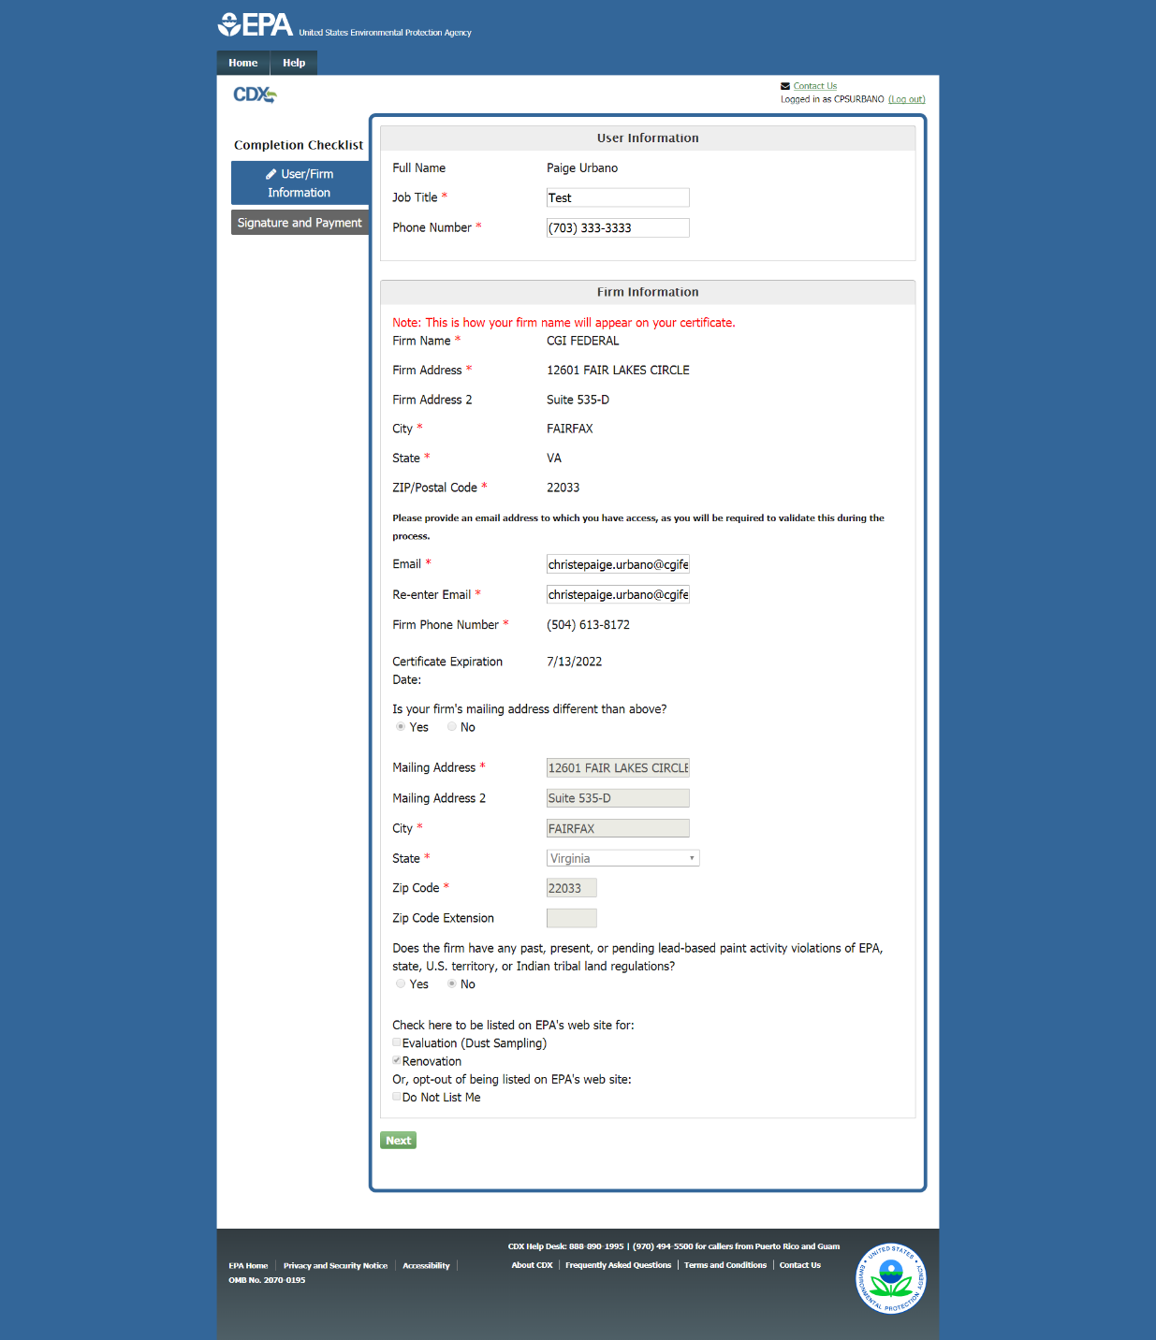
Replace a Certificate – User Information Page
Notes:
After signing in, the user is navigated to the user information page. The user is not able to edit their firm’s information on this page, this would need to be done separately through the “Update firm certification” option.

Slide 15
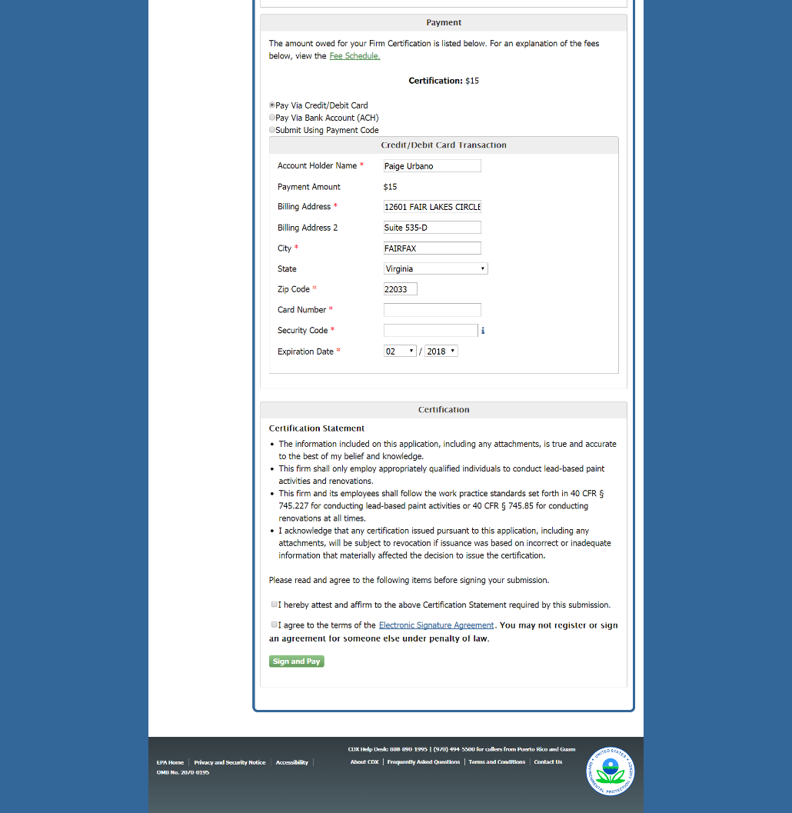
Replace a Certificate – Review and Payment Page
Notes:
The review and payment page will display the firm’s information and allow the user to pay for their certificate replacement request.

Slide 16
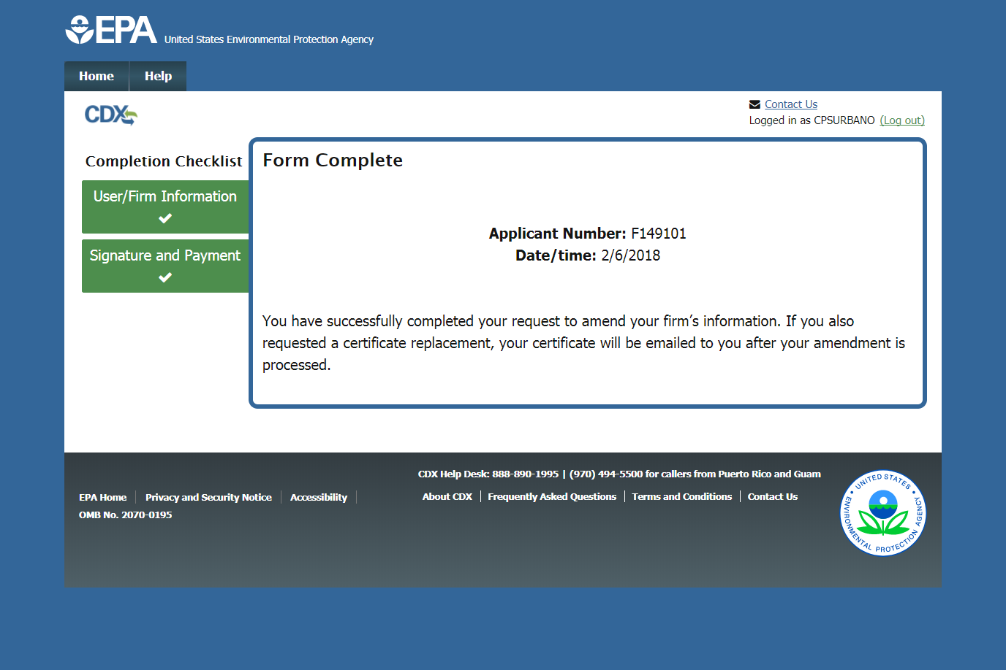
Replace a Certificate – Confirmation Page
Notes:
After signing their submission, the user is directed to the confirmation page.

Slide 17
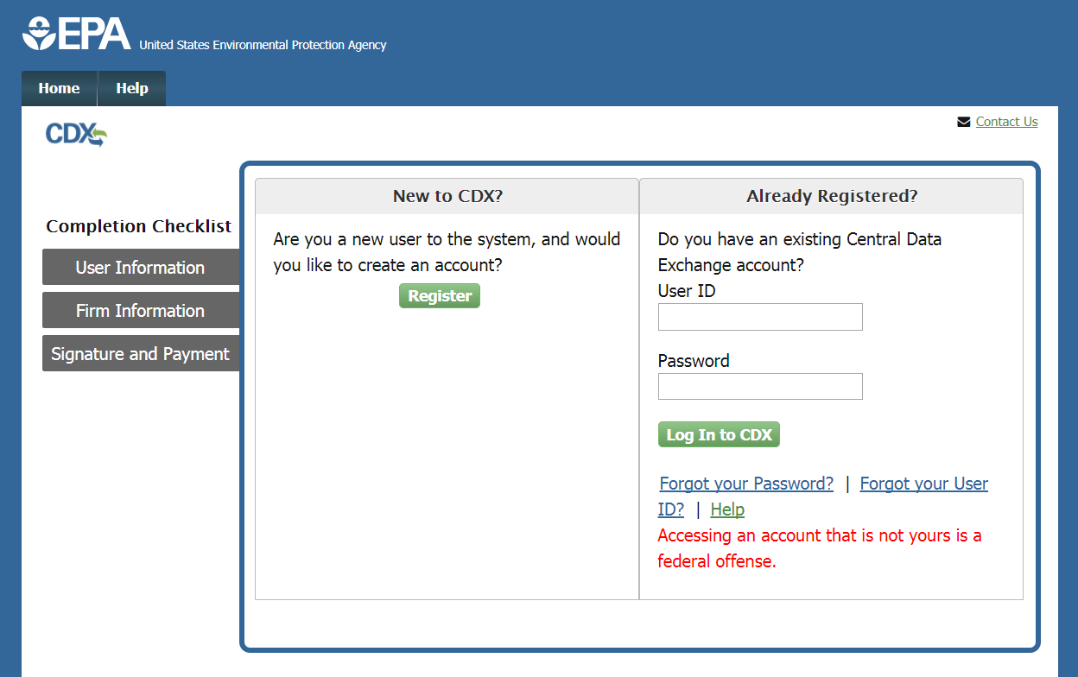
New Certification – CDX Register/Log In Page
Notes:
Once you select an application, you will be directed to the CDX Register/Log In page. If you have previously used the Central Data Exchange for reporting, type your CDX user ID and password and click the “Log In to CDX” button. If you have a CDX account but have forgotten your User ID or password, click the appropriate links and follow the steps provided to recover that information. If you are new to CDX, click the “Register” button to create a new account.

Slide 18
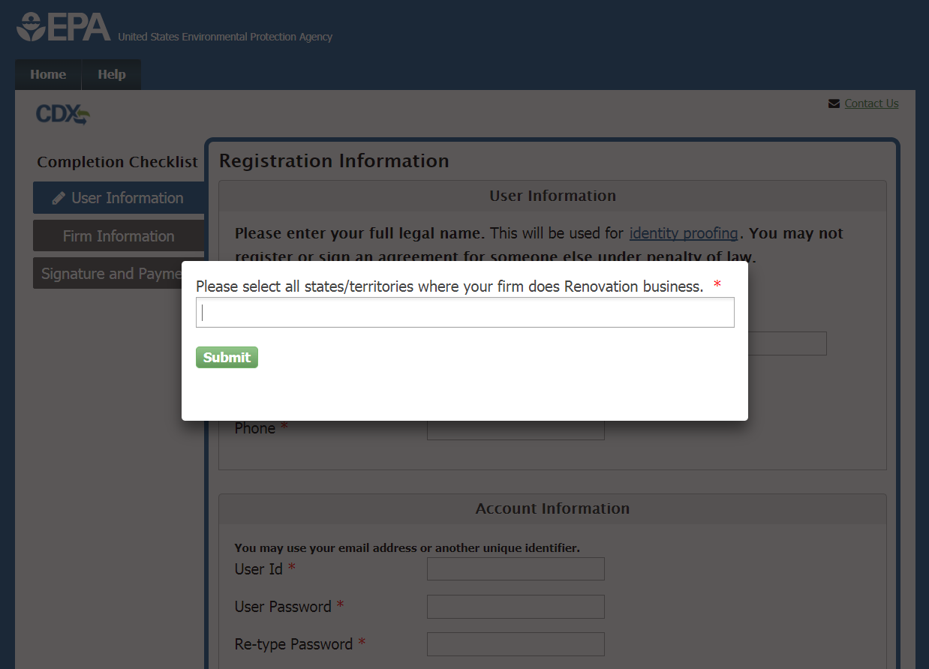
State/Territory Selection
Notes:
New and existing CDX users will first be prompted to list all states/territories where they will be doing their Renovation and/or Abatement business.

Slide 19
State/Territory Selection
Notes:
The user will see this message if they enter states/territories where an EPA certification will allow them to perform work.

Slide 20
State/Territory Selection – EPA-Authorized States
Notes:
If a user enters a state that does its own authorization, the user will be notified and linked to the state’s page.

Slide 21
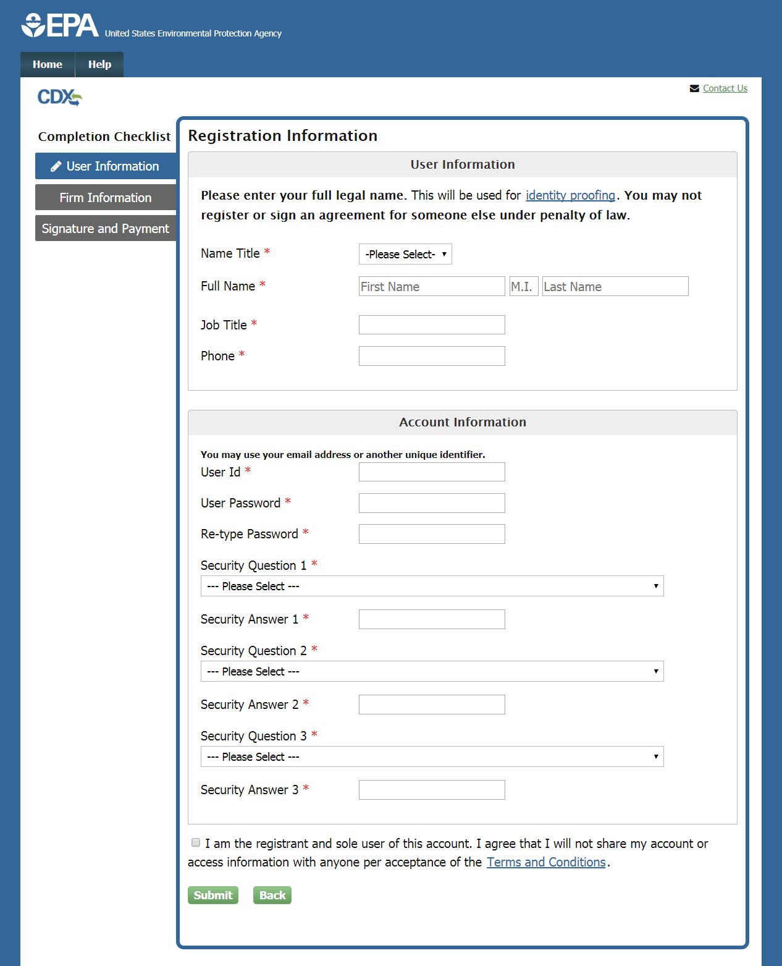
Registration Information Page – New CDX Account
Notes:
The first part of the application for first-time CDX users is the “User Information” page. The user must enter the appropriate information in the fields in this section. The user must use their full legal name in the “Full Name” fields as this information will be used for electronic identity proofing. For more information on the identity proofing process, click the “identity proofing” link. On this page, the user also creates their CDX user ID and password. This will be the information they will have to enter to log into their CDX account. The user may use their email address or another screen name for their user ID; the user should not use their social security number as their user ID. The user should be careful to remember the password that they choose, for this will be used to sign the application. Select three security questions and enter answers for each that you will remember but are hard to guess. Before continuing, click the link to open and carefully read the Terms and Conditions of the CDX system. Select the check box to agree to the Terms and Conditions before continuing by clicking the “Submit” button.

Slide 22
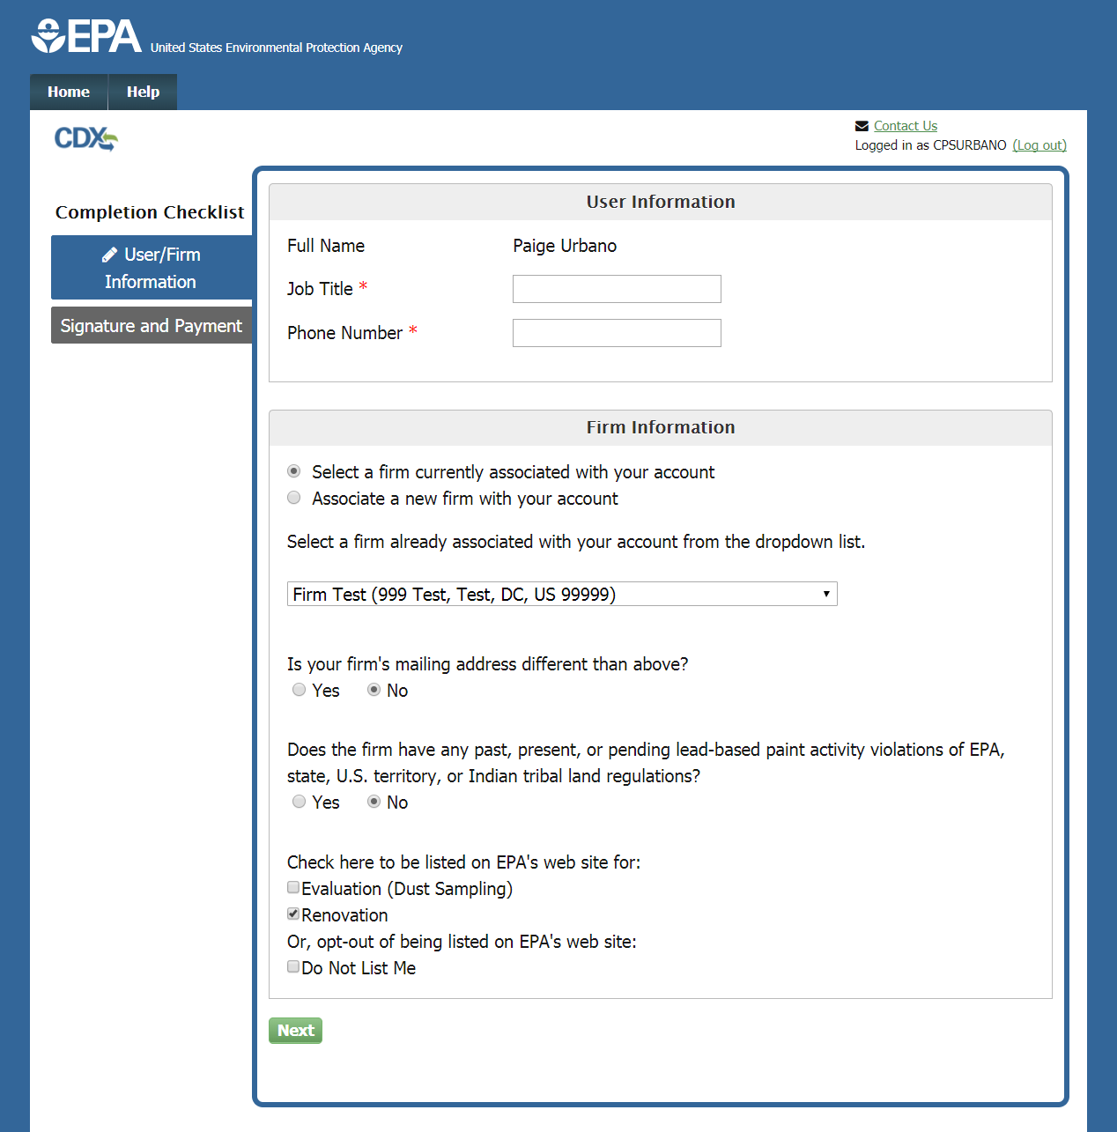
User Information Page – Existing CDX Account
Notes:
If you have logged in as a previous CDX user, you will not have to complete the User Information page. Simply enter your job title and phone number in the User Information section. Logged in users will also have the option to select a firm that is already associated with their CDX account by choosing from a dropdown menu. To add a new firm instead, click the appropriate radio button.

Slide 23
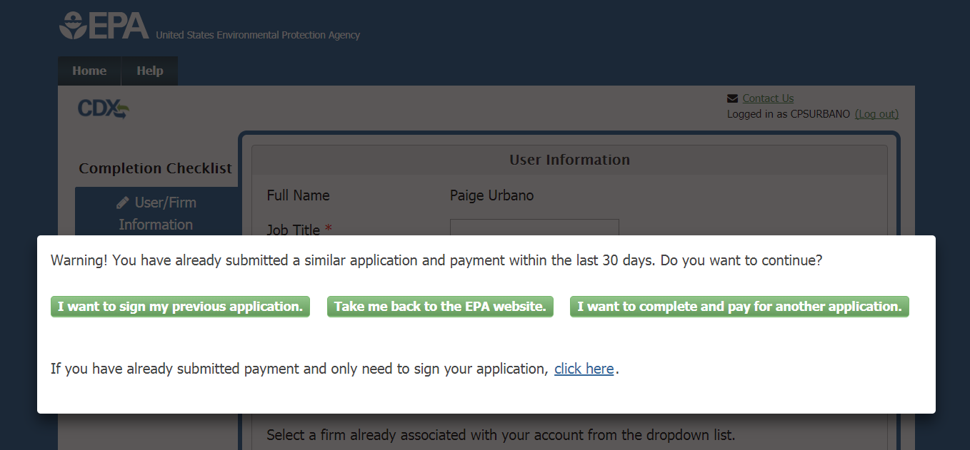
Recent Submission Warning
Notes:
If you receive this message when logging into your CDX account, you have submitted a Lead Firm Certification application within the last 30 days. If you believe this is correct and no further action is needed, click the “Take me back to the EPA website” button to exit the application. If you believe that your previous submission is complete but has not been signed, click “I want to sign my previous application” to re-enter the application process where you left off. In rare cases, a user may wish to submit and pay for multiple applications. For example, you may be applying for certification for two branches of a business which require separate certifications. If this applies to you, click “I want to complete and pay for another application” to begin a new electronic application. Selecting this option will require you to pay the full fee for the new application, so you should only select this if you are sure it applies to you.

Slide 24
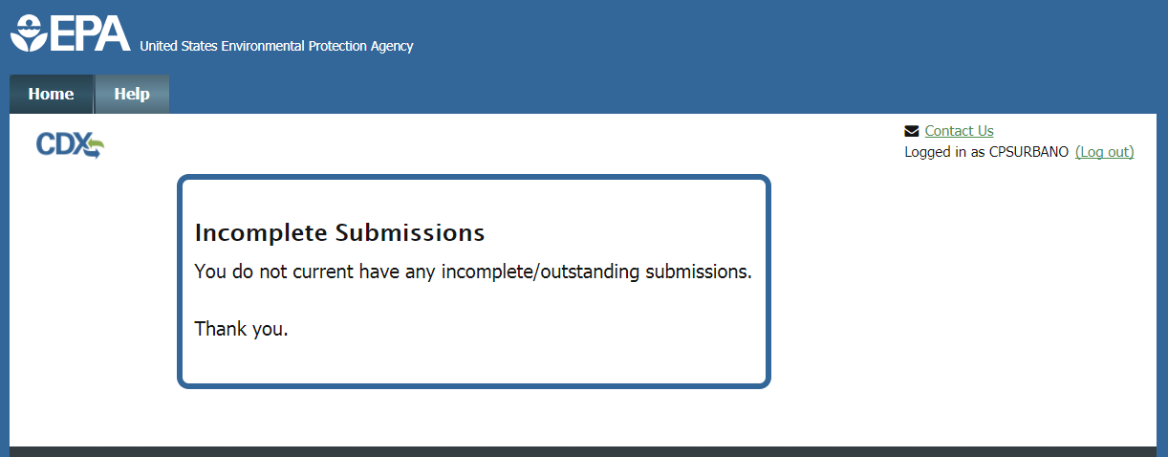
Incomplete Submissions
Notes:
Clicking “I want to sign my previous application” on the prior screen will take you back into the system to sign any outstanding submissions. In most cases you will see this page, indicating that you do not have any incomplete submissions. If this is the case, your previous submission was successfully signed and no further action is required.

Slide 25
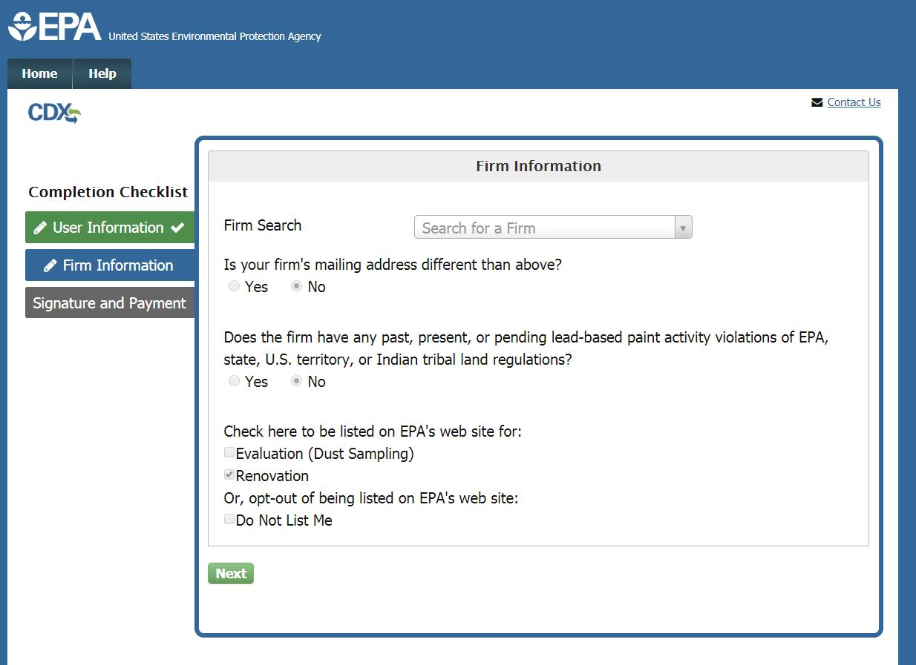
Firm Information Page
Notes:
On the Firm Information page, search for your firm by entering the firm name in the Firm Search box. Enter at least three characters in the search and the results will automatically be filtered as you type.

Slide 26
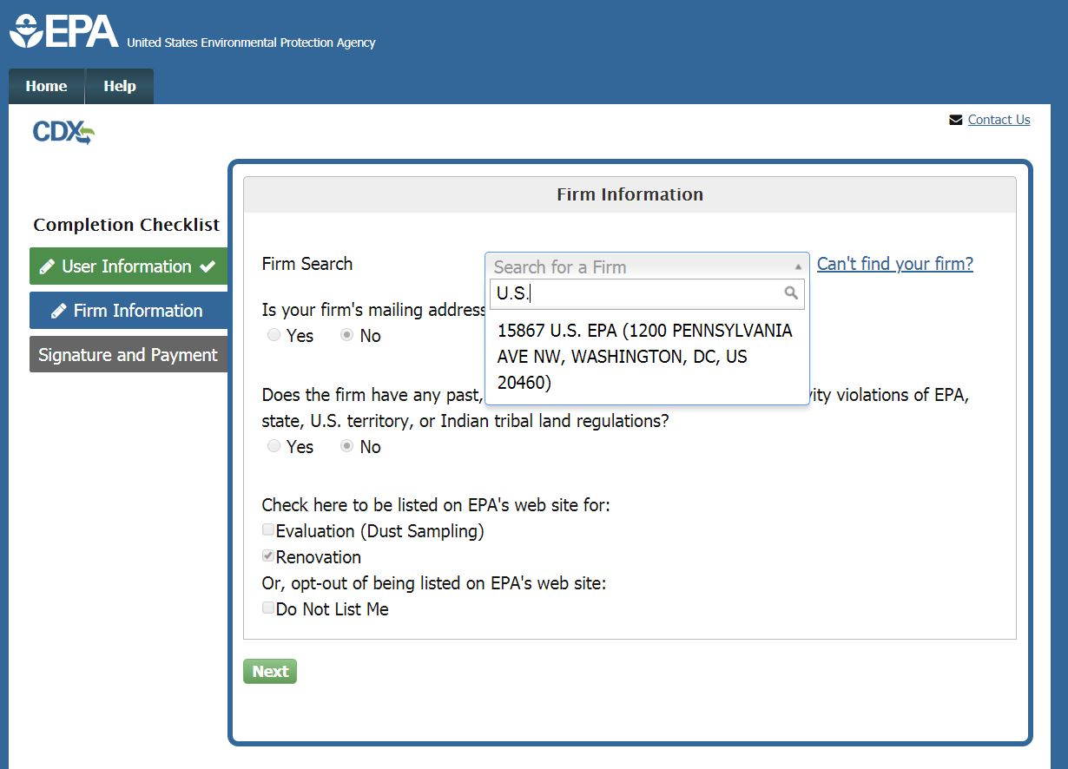
Firm Search
Notes:
If your firm is listed in the search results, select it from the list and verify that the firm name and address displayed is correct for your firm. There may be multiple firms with similar names; please verify that the displayed address indicates that you have selected your firm. If your firm is not listed, click “Can’t Find your Firm” to create a new firm in the system. You can also click the “Use advanced search” option to search by other criteria. If you are completing a Recertification application, the Firm Information section will be prepopulated for you.

Slide 27
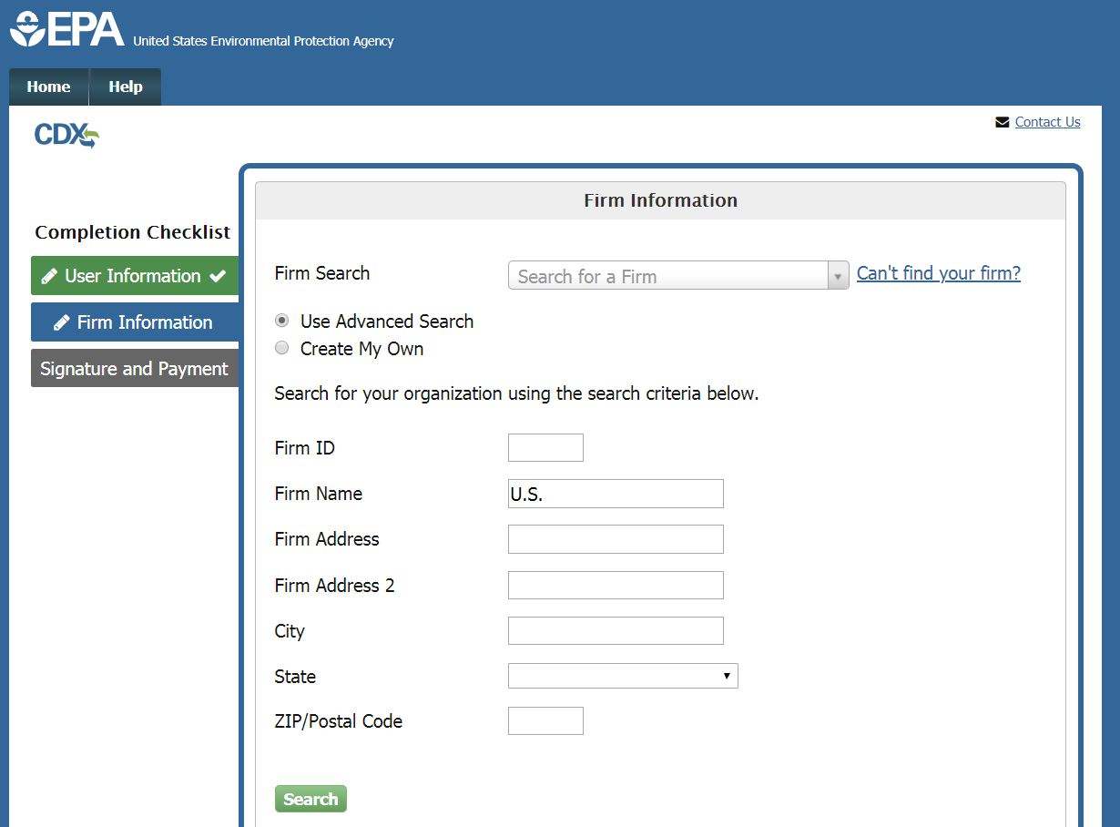
Firm Advanced Search
Notes:
Selecting the Advanced Search option will allow you to search for your firm by a variety of search criteria including; Firm ID, Firm Name, and Firm Address. Enter at least one of these criteria and click “Search” to search for your firm.

Slide 28
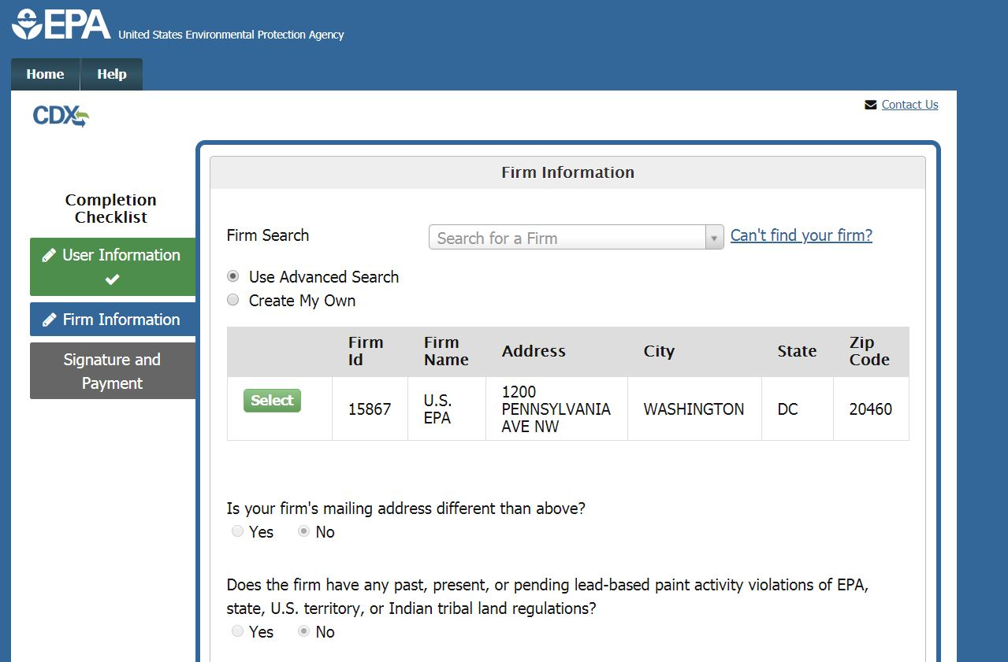
Advanced Search Results
Notes:
The results of the advanced search will be displayed in a table. If your firm is displayed in the list, click the “Select” button to the left of the appropriate firm. If it is not, click the “Request that we add your firm” link to manually enter the firm’s information.

Slide 29
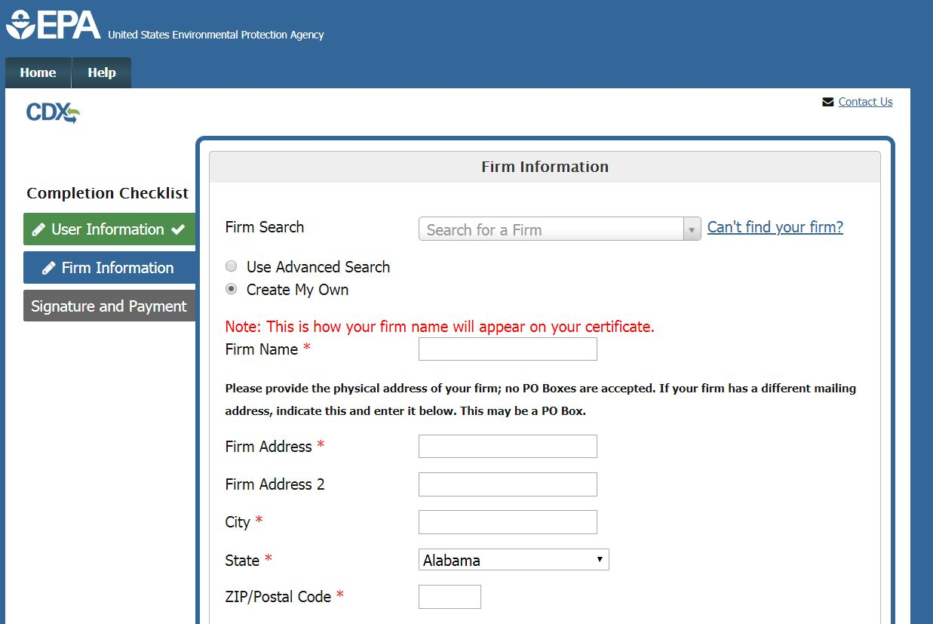
‘Create My Own’ Firm Option
Notes:
To request to add a new firm to the database, enter the required information in this form. Please note you can not provide a P.O. Box for your firm’s address. Later in the form you will have the option to add a mailing address to your firm, where you may indicate that you wish to receive mail at a P.O. Box.

Slide 30
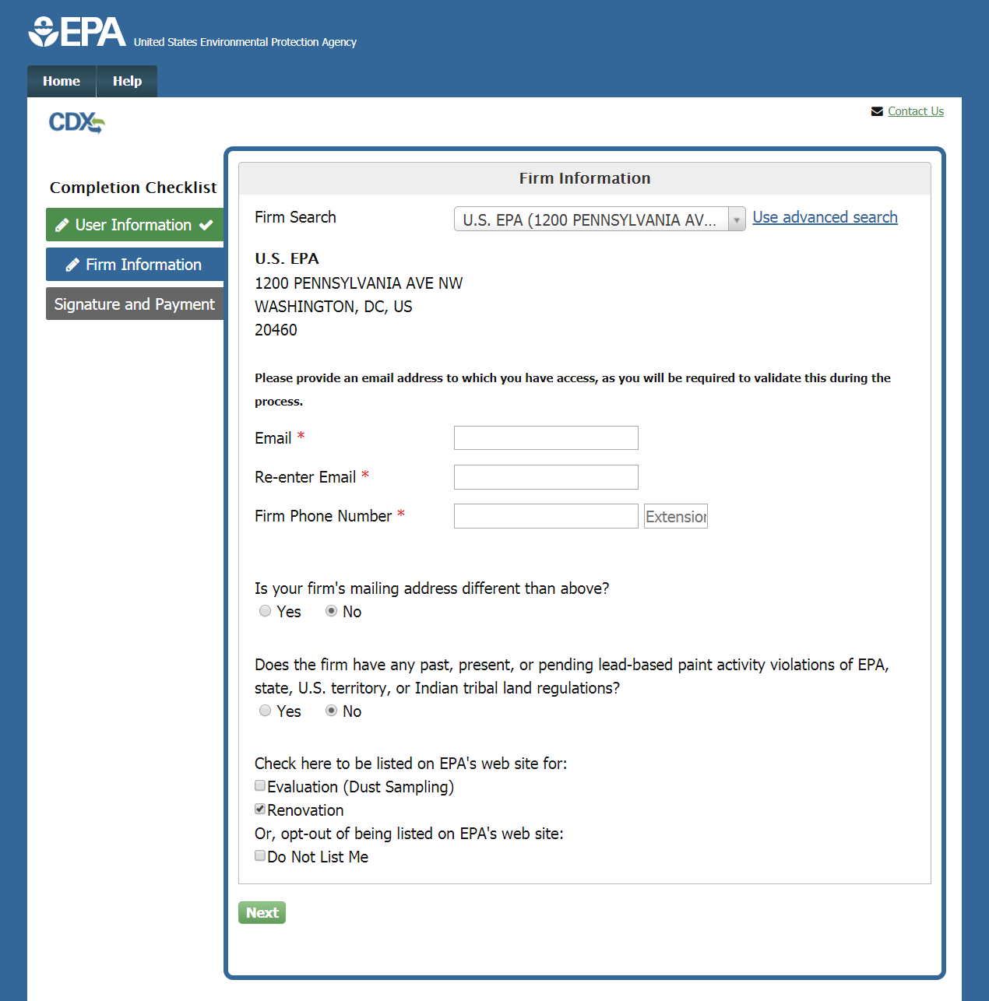
Firm Information
Notes:
Once you have selected your firm from the list, verify that its name and address are displayed correctly. Enter and confirm your email address and provide the Firm Phone Number and extension, if applicable.

Slide 31
Firm Information, Violation History, Listing Preference
Notes:
If your firm has a mailing address that is different from the physical address listed, select the “Yes” button to open the Mailing Address fields and enter the appropriate information. Indicate whether your firm does or does not have any past, present, or pending lead-based paint activity violations of EPA, state, U.S. territory, or Indian tribal land regulations by selecting either the “Yes" or “No” radio button. If you select “Yes,” a text box will appear for you to provide a required explanation. At the bottom of the page, you can choose whether you want your firm to be listed on the EPA website for Renovation, Lead Abatement, and/or Evaluation. You may select one or more of these options or select “Do not list me” to be omitted. Click “Next” once the page is complete to continue your application.

Slide 32
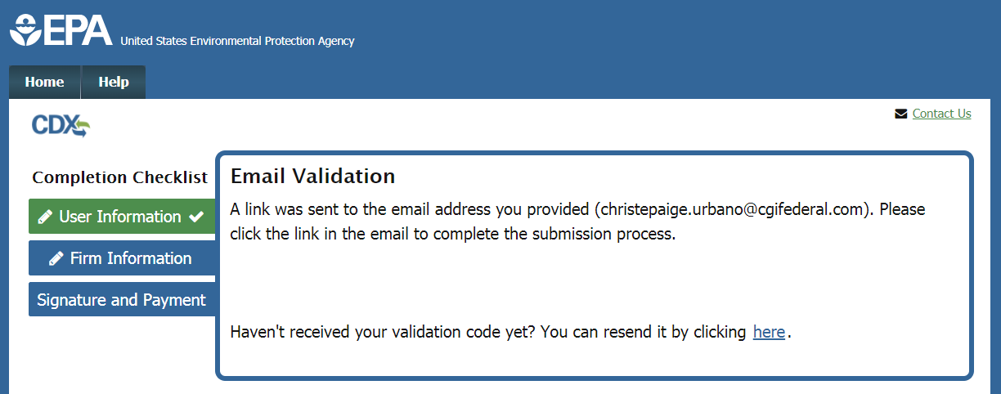
Email Validation
Notes:
Once you complete your application, an email will be sent to the email address provided containing a validation link.

Slide 33
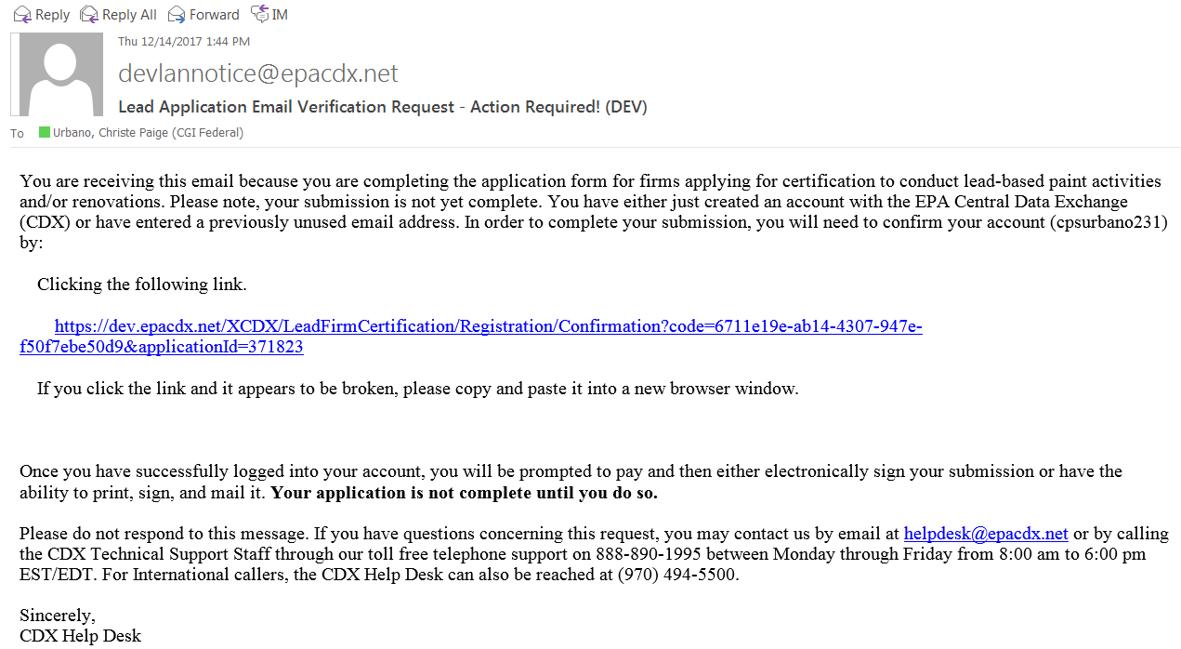
Email Validation
Notes:
Above is an example of the email you will have received. Click the link to validate your email.

Slide 34
Review and Payment Page
Notes:
On the Review and Payment page, verify that the information displayed in read-only format is correct and complete. If any changes are required, click the “Edit” button next to the appropriate section on the page.

Slide 35
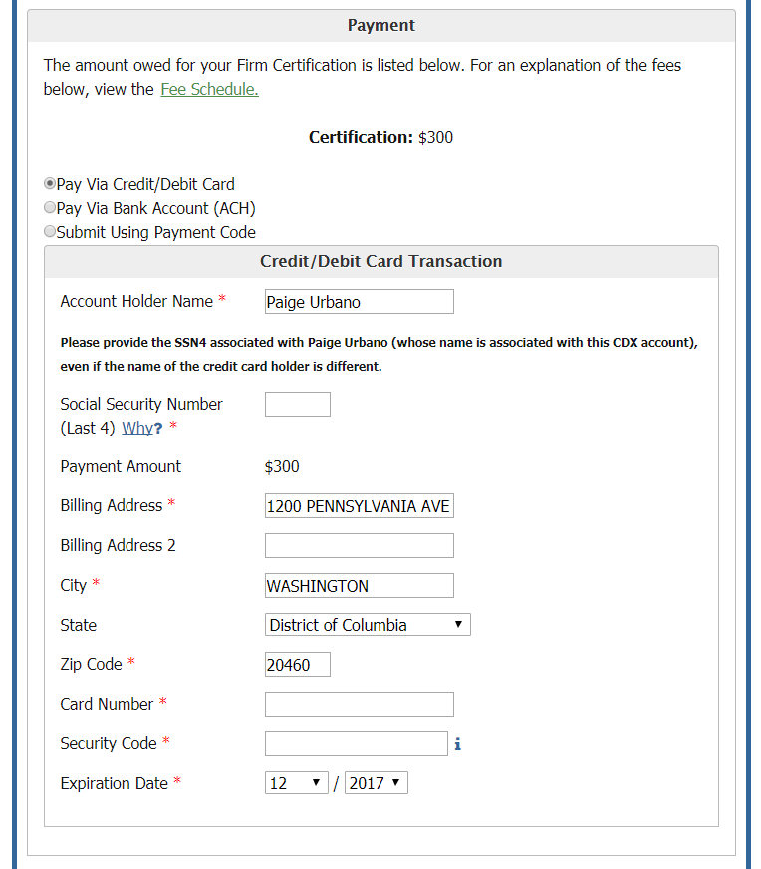
Paying with Credit Card
Notes:
The total cost of your certification is displayed in the Payment section. You may select to pay this amount either by credit or debit card, with a bank account ACH transfer, or with a payment code. Select the appropriate method by clicking the radio button next to your selection. To pay by credit or debit card, enter the card number, security code, and expiration date of the card. If the name or address of the cardholder is different from what is displayed, edit those fields. For identity proofing purposes, enter the last four digits of your social security number in the corresponding field. Please provide the social security number of the person whose name is associated with the CDX account, and not the cardholder, if the two are different. The name associated with the CDX account is displayed above the SSN field.
The credit card expiration fields are defaulted to the current month and year. The month drop down does not display the months of the year that have passed unless the year option is changed. If the user is having trouble finding the desired month in the month dropdown, first change the year in the year dropdown, then select the desired month.

Slide 36
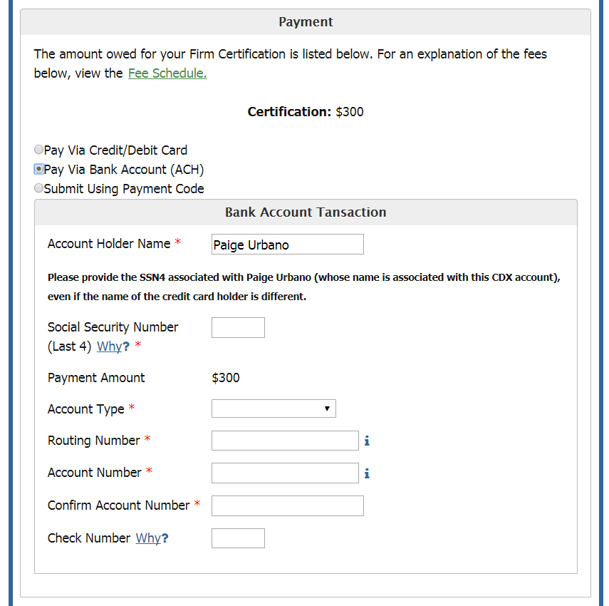
Paying with a Bank Account Transfer (ACH)
Notes:
To pay with a bank account transfer, select the account type and enter the routing number and account number. As in the case of credit or debit card payments, you must enter the last 4 digits of your social security number in the appropriate field. Please provide the social security number of the individual whose name is associated with the CDX account rather than the bank account holder, if the two are different. When you have completed this information, click the “Complete payment” button to submit and pay for your application.

Slide 37
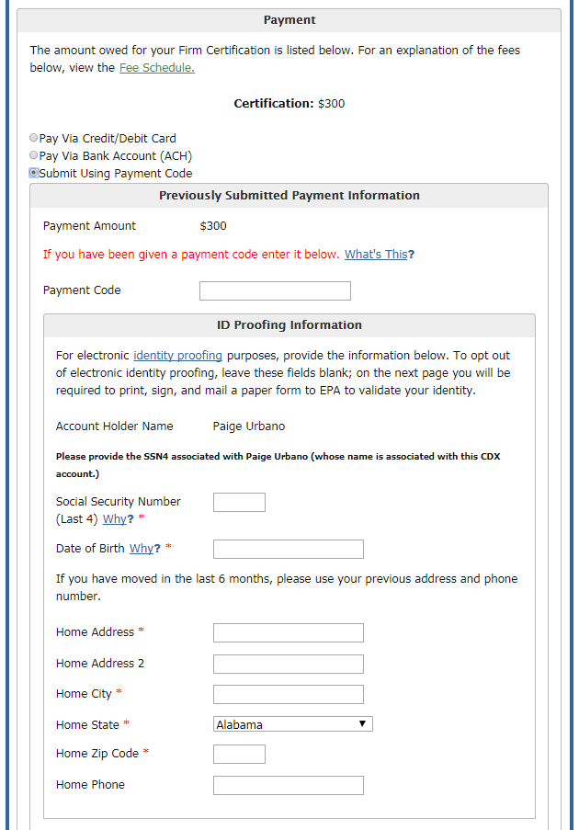
Paying with a Payment Code
Notes:
To pay with a payment code, enter the payment code provided to you in the appropriate field. For the identity proofing portion, enter the last 4 digits of your social security number, your date of birth, and your home address. Be sure to enter the identity proofing information for the person whose name is associated with the CDX account, seen in this section as Account Holder Name.

Slide 38
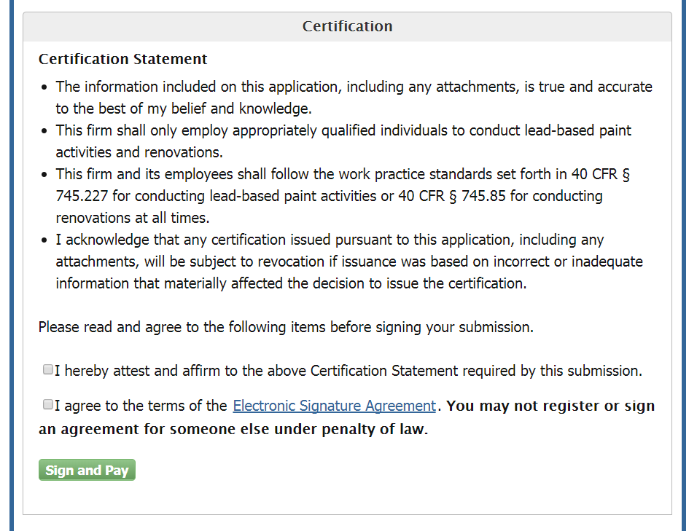
Certification Statement
Notes:
The last section on the Review and Payment page is the Certification section. Read the full text of the Certification Statement as displayed, and affirm your acceptance of the terms. Clicking the link to the Electronic Signature Agreement will display the full text of the document. To sign, you must check both of the boxes to affirm both statements.

Slide 39
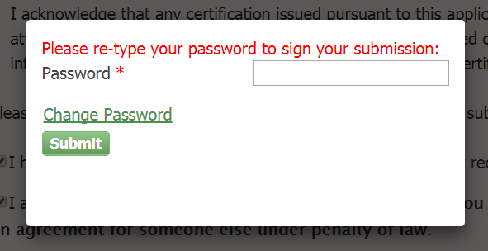
Signature Request
Notes:
Once you have checked both of the boxes and completed all application fields, clicking “Sign and Pay” will open a pop-up window. Enter the password you created in the first part of the application to continue.

Slide 40
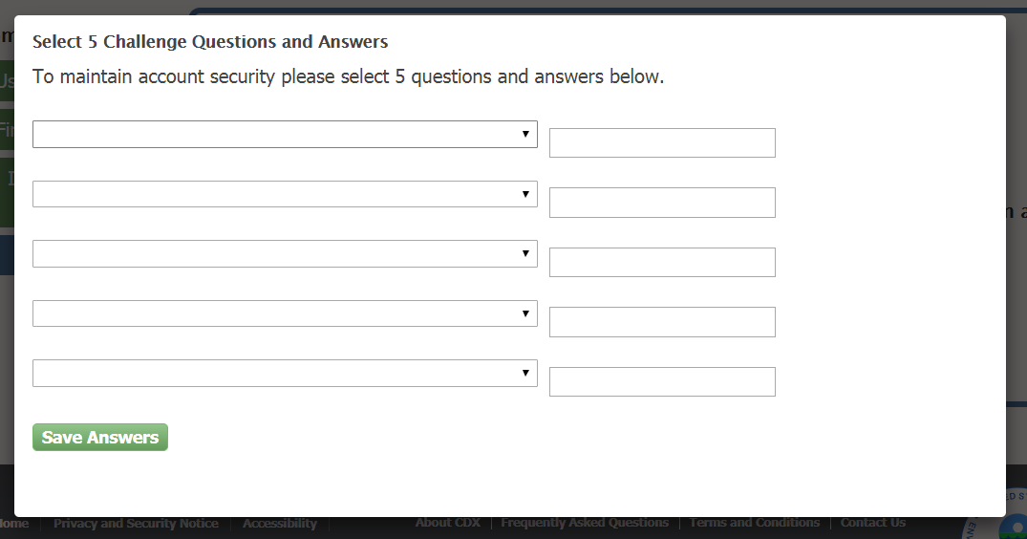
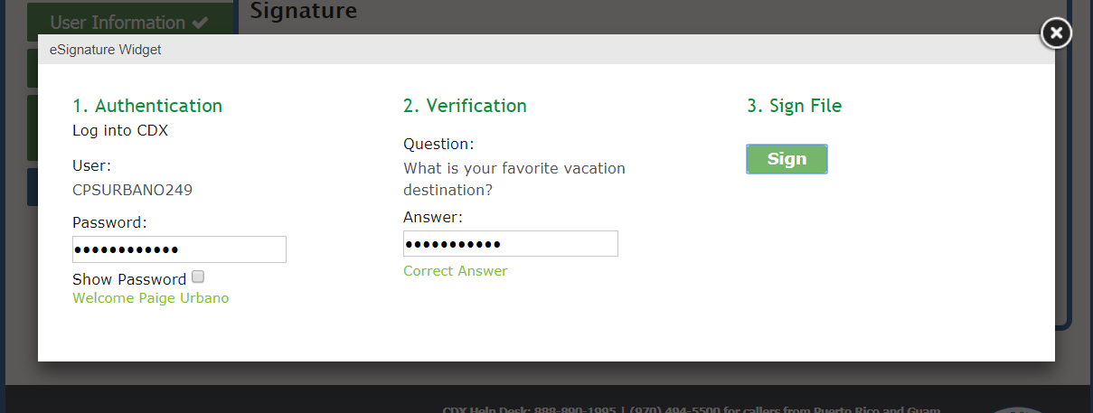
Security Questions and eSignature Widget
Notes:
You will then be prompted to select five security questions and answers. After selecting your security questions, the eSignature widget will appear. Complete the eSignature widget by entering your password and answering the security question.

Slide 41
Processing Request
Notes:
The process for submitting the application and processing payment may take a few minutes. It is important that you do not close the window while the system is processing, or you may incur multiple payment charges.

Slide 42
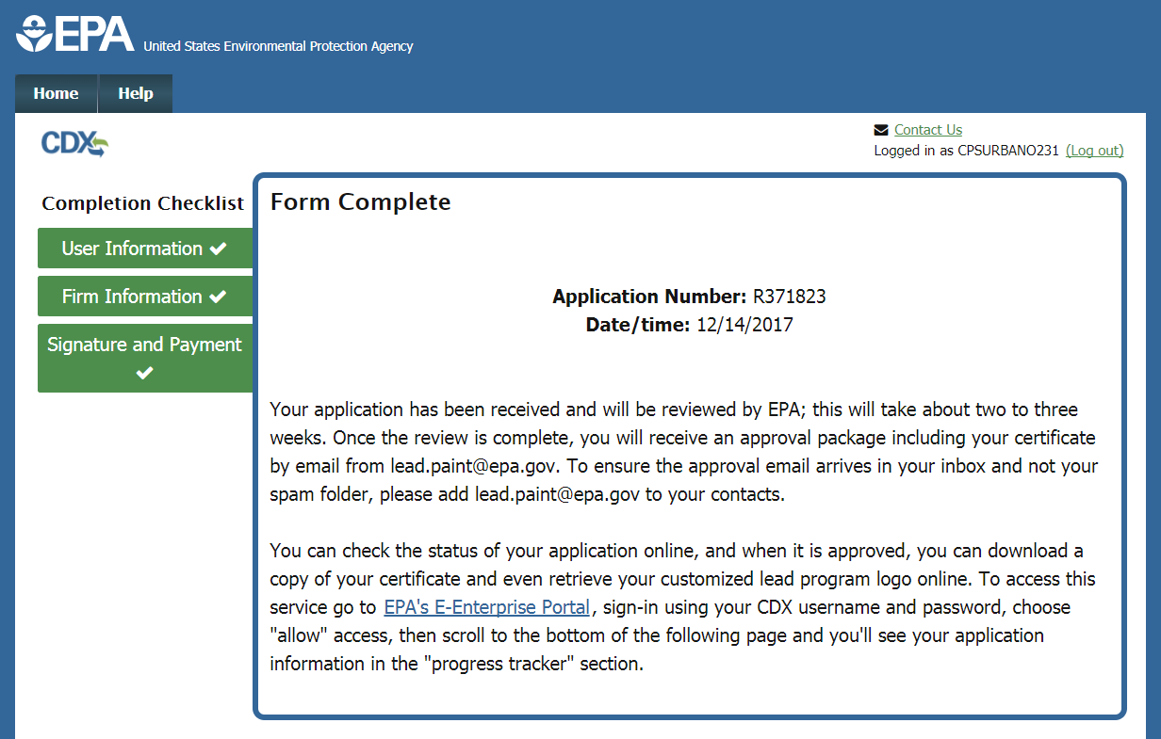
Submission Confirmation
Notes:
Once your application is complete and has been signed, you have completed the process. If you pass the electronic Identity Proofing process, your password is considered your legal signature and your application is complete. On this page, you will see your application number and the date that your application was signed. Your application will now be reviewed by EPA. Once the review is complete, you will receive a confirmation email from EPA with details.

Slide 43
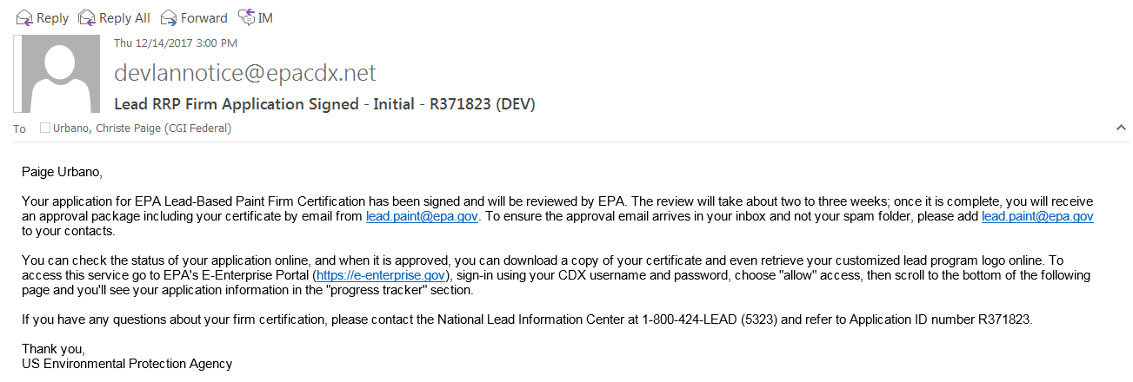
Confirmation Email
Notes:
If your application is complete and signed, you will receive an email such as the above to confirm .

Slide 44
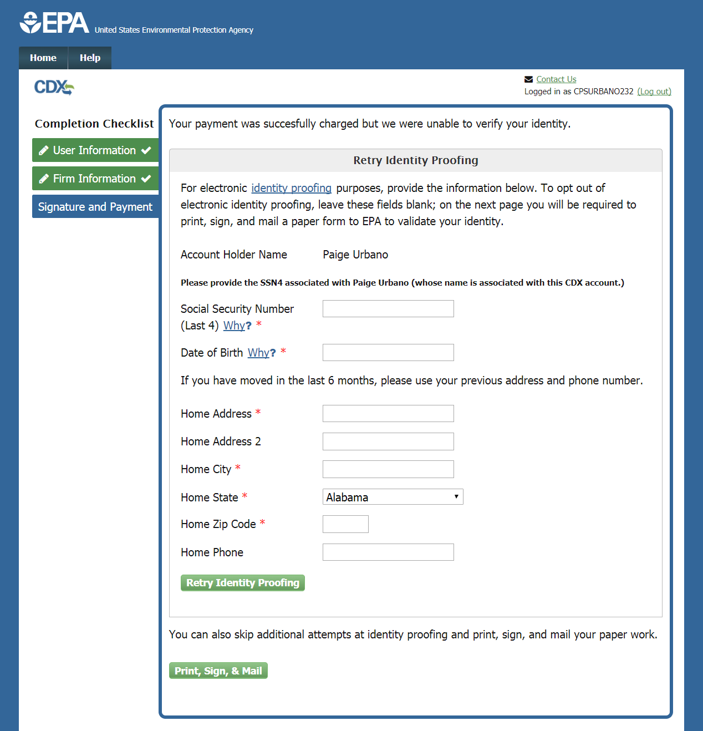
Identity Proofing Retry
Notes:
If you do not pass the electronic identity proofing process you can retry on this page, or choose to print, sign, and mail the paper form of the Electronic Signature Agreement and Submission Certification Statement to EPA. Your electronic application has been submitted, but not signed; it will be considered signed upon receipt of this paper form with your signature. The address to which you must mail this form is displayed at the bottom of the document.

Slide 45
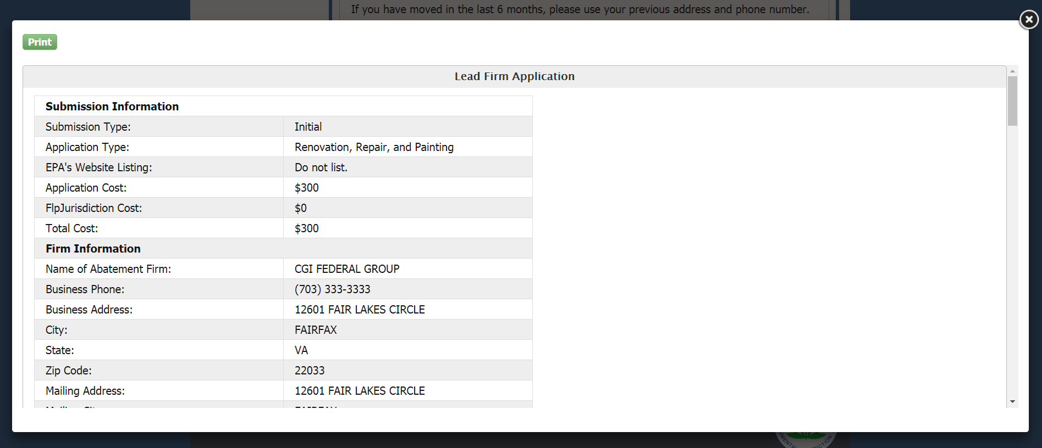
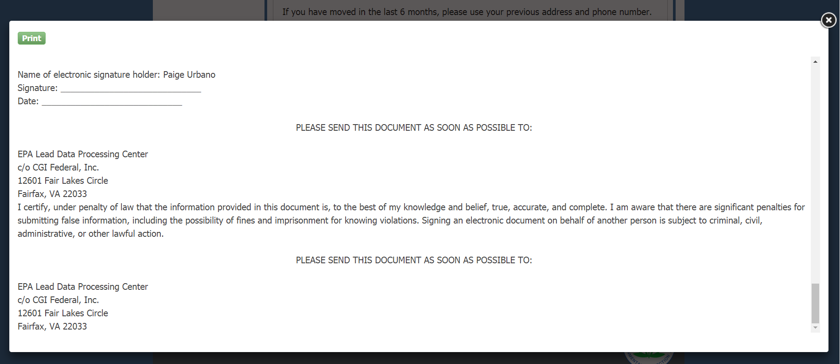
Electronic Signature Agreement (ESA)
Notes:
Click the “Print, Sign, & Mail” button to generate the Electronic Signature Agreement. You must print, sign, and mail this page to the address listed at the bottom of the document.

Slide 46
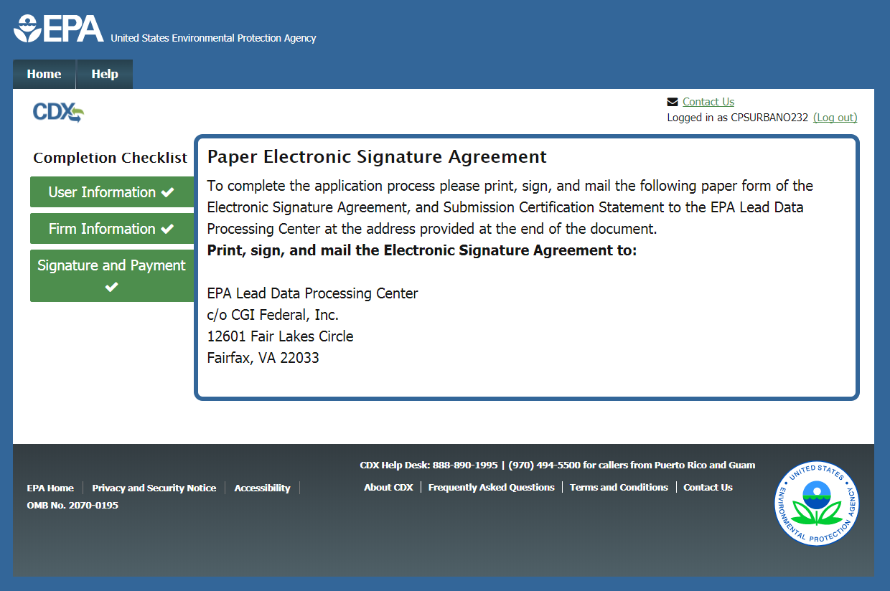
Electronic Signature Agreement (ESA)
Notes:
Once the document is printed, the address is displayed on the screen as well.

Slide 47
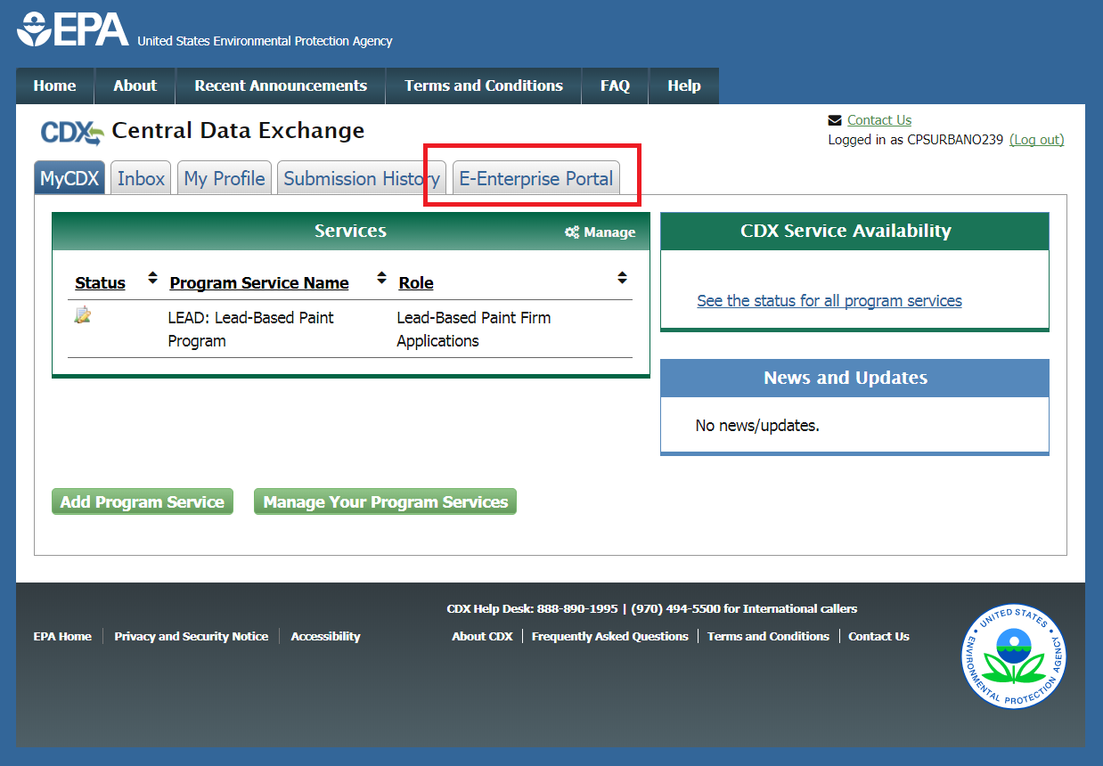
E-Enterprise Portal Link
Notes:
Users can now check on the status of their application by accessing the E-Enterprise Portal (E-Portal). After the user has submitted their Firm application, they can access the E-Portal by clicking the “E-Enterprise Portal” tab on the CDX home page.

Slide 48
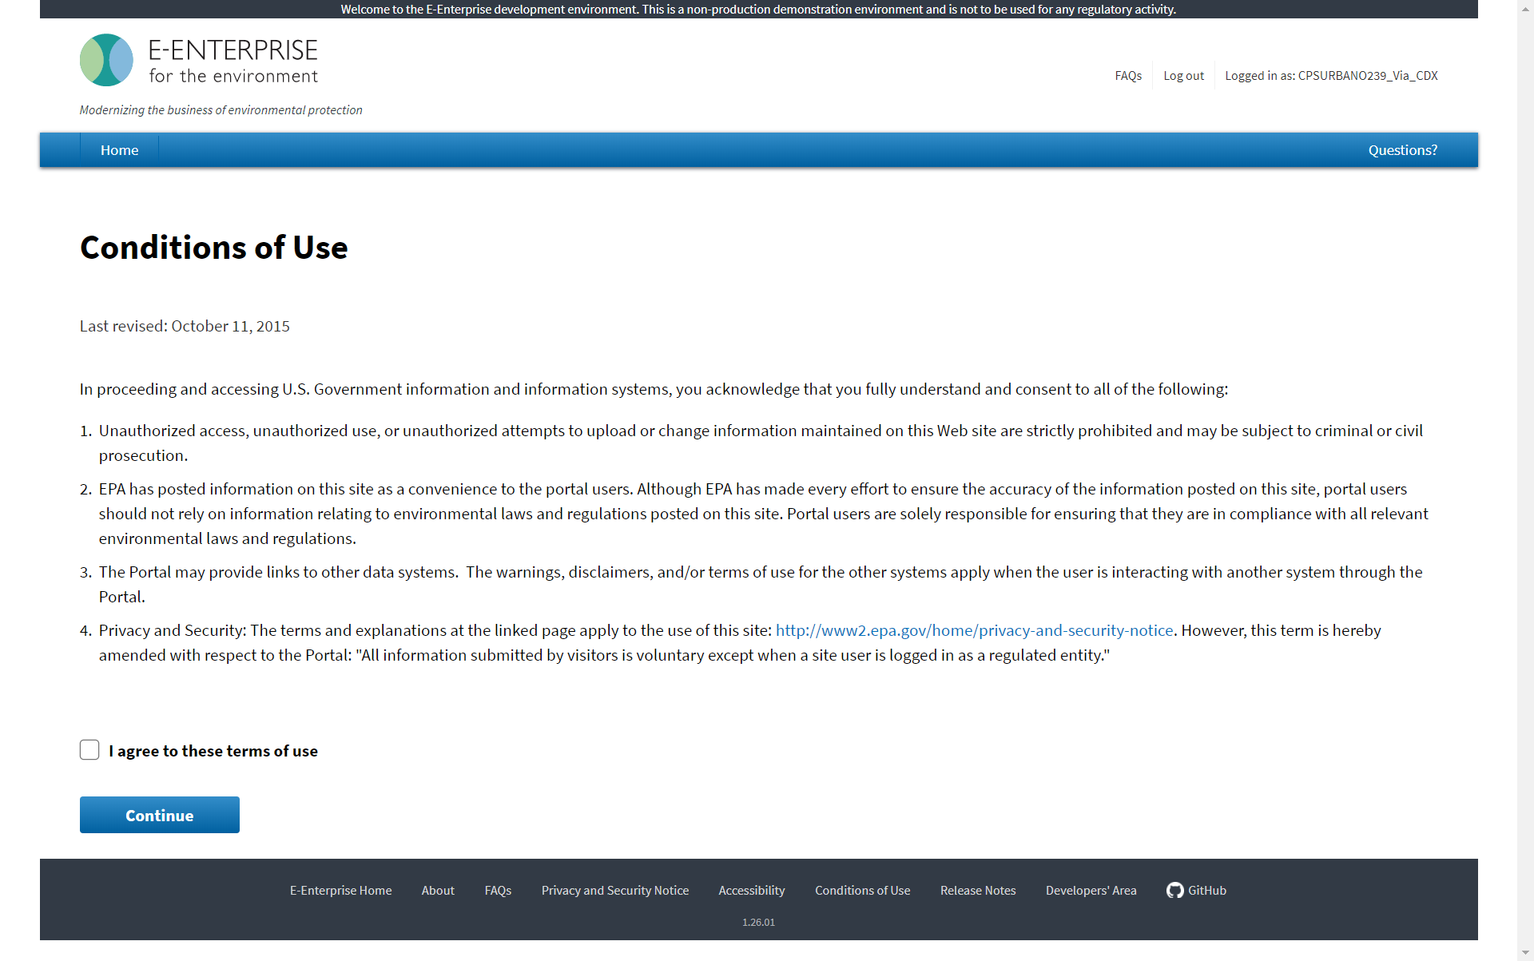
E-Enterprise Portal – Conditions of Use
Notes:
Users accessing the E-Portal for the first time will have to agree to the terms of use to continue.

Slide 49
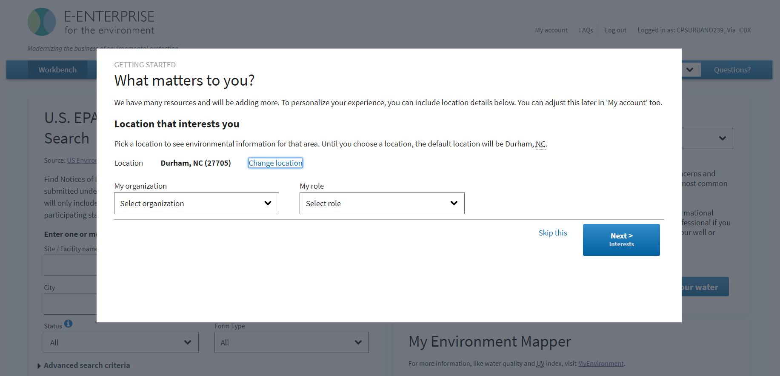
E-Enterprise Portal
Notes:
This pop-up window will appear after the user has agreed to the terms of use. Here, the user may customize their E-Portal based on their interests, or click “Skip this” to skip this portion.

Slide 50
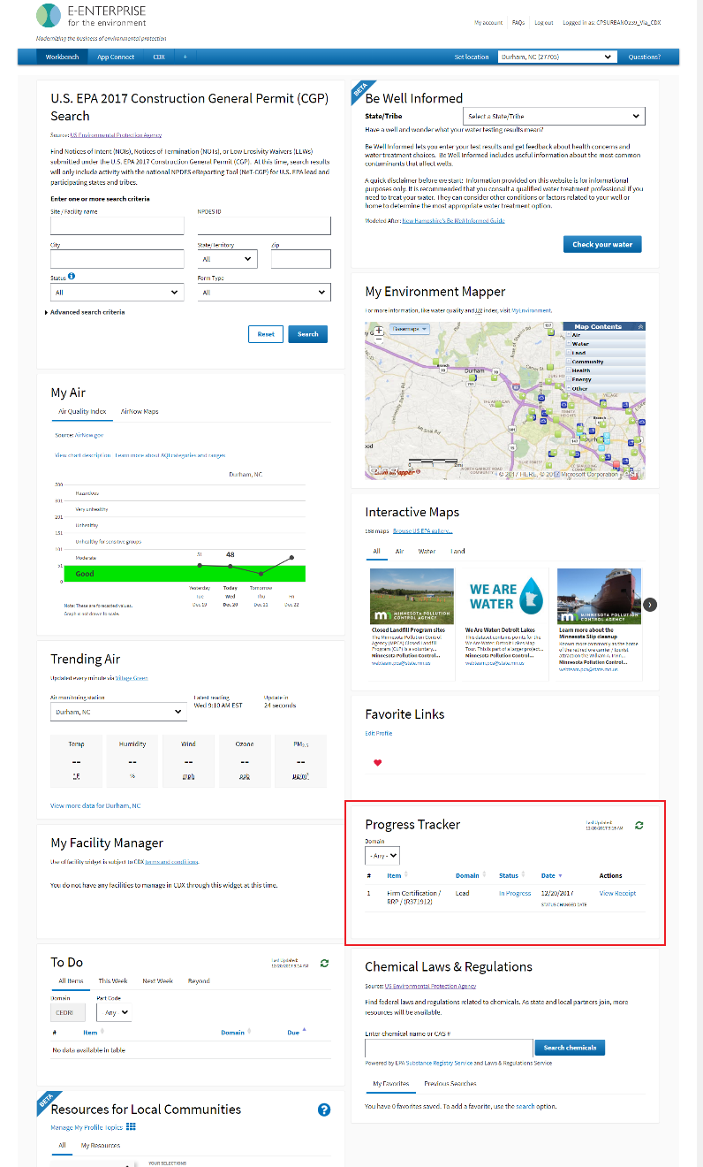
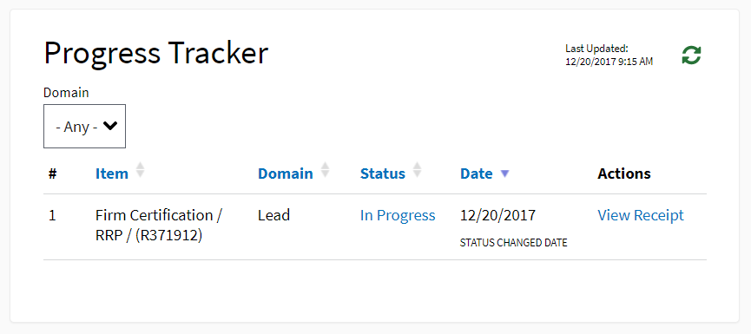
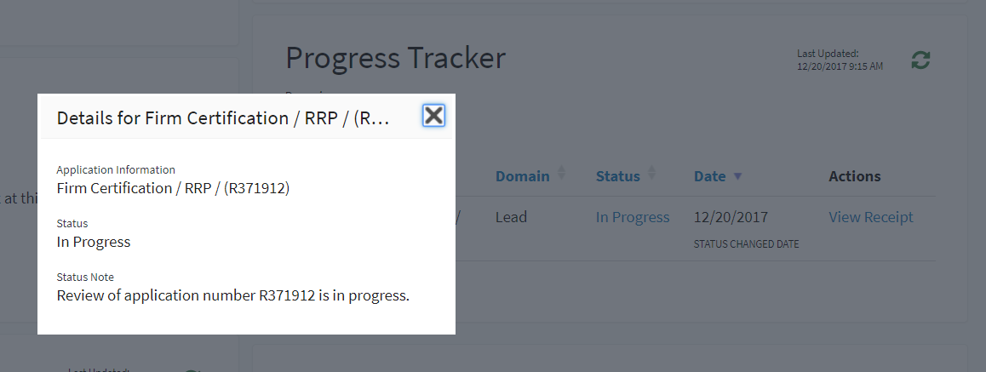
E-Enterprise Portal – Progress Tracker
Notes:
In the “Progress Tracker” portion of the E-Portal homepage, the user can track their Firm application. A copy of the user’s receipt is also available here.

Slide 51
Progress Tracker – Approved
Notes:
The application’s status will be changed to “Approved” once the application review process is completed. Please note: the application review process will take about 2-3 weeks. This processing window may be prolonged if the user is missing a component of their application.

Slide 52
Firm Certificate and Logo
Notes:
Once the user’s application is approved, copies of their certificate and logo will be made available on the E-Portal. This will be available to the user on the E-Portal for one year. After the year has elapsed, the user has the option to request a replacement certificate for $15.

Slide 53
Helpful Hints
Remember CDX password to sign application
Do not close browser window until you see the confirmation screen
Add lead.paint@epa.gov to your email’s safe senders list
Copy of certificate is available on the E-Enterprise Portal for one year
Notes:
To recap, here are a few helpful hints for successfully completing your application. First, be sure to keep track of your CDX password when you log in to the system, or when you create a new account. Second, do not close your browser window until you see the confirmation screen indicating that your application has been successfully submitted. It may take a few minutes to process, but do not close the window until the system indicates that it is safe to do so. Third, certain email systems may label communications from the Lead program as spam. To avoid this, please add lead.paint@epa.gov to your email’s list of safe senders. Finally, once your application is approved, a copy of your certificate will be available on the E-Portal for one year.
This concludes the Lead Firm Certification Application tutorial.

